Slide 1
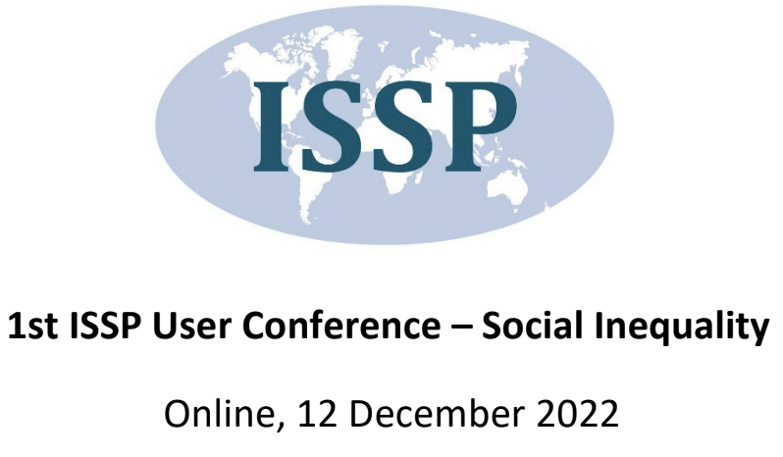
The moderating effect of subjective socioeconomic status (SSS) on the association between: Economic comfort and happiness
Atefeh Bagherianziarat Charles University, Prague
Supported by GA UK project
Project number: 371721

Slide 2
The challenge: Does higher socioeconomic status make people happier?
Needs’ theory: absolute material resources that are essential for fulfilling basic subsistence needs might have a strong impact on the subjective well-being;
Empirical evidence is very controversial on the association between economic stand and happiness
Easterlin paradox: rich individuals within nations are happier than poor ones, however, rising societal incomes do not seem to be associated with rising subjective well-being!
Notes:
The very question of “does higher socioeconomic status make people happier” is one of the most endured debates in the relevant literature.
Some studies confirmed the consistent and positive effect of economic condition and subjective well-being ( e.g., Barger et al., 2009; Frey & Stutzer, 2011; Pinquart & Sörensen, 2000; Daraei & Mohajery, 2013; Fassbender & Leyendecker, 2018; Chiang et al., 2021; Reyes et al., 2020). This finding, however, has been under question by some other studies showing the insignificant or very weak association of income and SWB (Nettle, 2005; Kahneman et al., 2006; Layard, 2011). When this association is measured in a country-level account, the findings are even less consistent: while a strong effect of GDP on the populations' mean level of SWB has been demonstrated (e.g., DiTella, MacCulloch & Oswald, 2003; Hagerty & Veenhoven, 2003; Stevenson & Wolfers, 2008), some other studies indicated that an increase in GDP over time does not increase populations’ mean SWB (e.g., Easterlin 1973, 1974, 1995; Easterlin & Angelescu, 2009).

Slide 3
Socio-psychological theories’ suggestions to explain the paradoxical association
Some socio-psychological mechanisms that underly the relationship between wealth and happiness:
Perceived fairness of the system;
Why my social status is lower?
Social deprivation (exposure to inequality);
Social support;
Openness of society (social mobility and future opportunities);
Social norms (how a given society values being rich);
Considering individuals’ perception of their economic stands instead of their actual economic status
Subjective social status (SSS);
Empirical studies confirmed that SSS determines happiness/MWB beyond and above actual economic status
Notes:
Basically, the efforts were suggesting some other socio-psychological factors that moderate or mediate this association such as:
To explain this controversy, researchers have entered various variables in their theoretical and empirical models which mediate/moderate the link between income and MWB such as subjective socioeconomic status (Johnson & Krueger, 2006; Hoebel et al., 2017; Scott, 2014) personality (Syrén, et al., 2020; Boyce & Wood, 2011), social support (Schulz, et al., 2006) social deprivation (Cheung & Kee-Lee Chou, 2019), social norm (e.g., Diener, Suh, Lucas, & Smith, 1999; Adriaans, 2022), etc
A possible reason that income might vary in its association with rising SWB is that people’s material aspirations might also rise, sometimes more quickly than income. If people want and expect more income and material possessions, and therefore require more money to be satisfied, SWB might be flat or even declining despite rising incomes. Graham and Pettinato (2002) found that “frustrated achievers” can become less satisfied even as their incomes rise because their aspirations increase even more quickly than their incomes.

Slide 4
The remained gap: the interplay of subjective and objective socioeconomic status
SSS
Economic stand
happiness
happiness
Economic stand
SSS
Economic stand
happiness
?
SSS
Notes:
So far studies mostly focused on the main effect of SSS on mental well-being or happiness compared to that of actual economic status. Also, only some limited studies have considered SSS as a mechanism that mediates the association between income and the components of wellbeing . However, particularly the moderating effect of Subjective social status on happiness has remained relatively unexplored.

Slide 5
Our hypothesizes and analytical model
Drawing on social comparison theory, we assume that:
Economic stand of individuals impacts positively their happiness;
individuals’ perception of their social status impacts their happiness stronger than their actual economic stand;
The impact of individuals’ economic stand on their happiness reduces, if they consider their social status to be lower than others;
Economic stand
Happiness
Subjective social status
Notes:
The impact of economic stand on happiness depends on the social status they consider for themselves.
social comparison theories that elaborate the socio-psychological mechanisms through which assuming a lower social status compared to others can impact negatively mental health and both mental and social well-being. Through the stresses related to social deprivation and social comparison.

Slide 6
The method
ISSP data, module 2019, Czech modification,
A linear hierarchical regression model on the data while controlling for age, gender, education level and marital status of respondents
Variables:
Economic status: A five-point-rating-question asking respondents how comfortable they can live with their current household income
Subjective social status (SSS): A question asking respondents to choose one of five rating statuses as the one which represents their socioeconomic status the best;
Happiness: A ten-point-rating-question regarding the level respondents consider themselves happy
Notes:
Accordingly, we utilized ISSP data, module 2019, Czech modification, to test the study’s main hypothesis which assumes that the higher levels of SSS decreases the positive association between individuals’ economic condition and their happiness. We applied a linear regression model on the data while controlling for age, gender, education level and marital status of respondents. A five-point-rating-question asking respondents how comfortable they can live with their current household income has been considered as the indicator of economic comfortness. A question asking respondents to choose one of five rating statuses as the one which represents their socioeconomic status the best was considered as the indicator of SSS. And a ten-point-rating-question regarding the level respondents consider themselves happy was considered as the dependent variable of the studied model.

Slide 7
Results
The results supported our hypothesizes while challenging some previous studies’ findings;
Economic stand of individuals impacts positively their happiness (p: 0.74);
individuals’ perception of their social status impacts positively their happiness (P: 0.34), but not stronger than their economic comfort (p: 0.74);
The impact of individuals’ economic stand on their happiness reduces, if they consider their social status to be lower than others (P: -0.26);
Notes:
The results challenged some previous studies that confirmed the effect of SSS can be a stronger predictor of happiness rather than actual economic condition.
The main effect of economic comfort on happiness was significantly stronger than that of SSS on happiness, although both links were statistically significant even after entering the controlling variables into the model. (age, education, gender and marital status). This result is contradictory with some previous studies showing that perception of social status affects mental-wellbeing components above the actual economic condition
Nevertheless, consistent with social comparison theories and our main hypothesis, the moderation interaction effect of SSS and economic comfort on happiness was negative and significant, illustrating that having higher levels of economic stand does not increase individuals’ happiness at the same level. It deepens to some significant extends (-0.26) on the degree to which they consider themselves higher in socioeconomic status.

Slide 8
Conclusion
Social evaluation and comparison are important regarding happiness!
This importance might vary in different societies! (social and cultural context should be considered)
The less importance of SSS in the Czech Republic might be due to the higher level of equality in society!
The results support the theories that suggest regardless of the wealth people possess, living in an unequal situation will have negative outcomes regarding their personal and social well-being.
The main contribution of the study to the literature related to the interplay of subjective and objective inequality:
The effect of objective inequality –economic stand- on individuals’ MWB partially depends on their perception of their relative social status.
Notes:
Accordingly, we argue that both community and personal-level efforts regarding happiness should consider the factors that led people to get involved in evaluating themselves compared to others which both directly and indirectly impact their happiness.
However, this effect has been shown not to be the same in every society, therefore the influence of social and cultural contexts are required to be considered and investigated in other studies.
It can be assumed that the reason why in contrast with previous studies the impact of SSS on happiness is not stronger that that of economic stand is that Czech republic is one if the most equal countries in Europe. As such, people are less exposed to social inequality, and it reduces the importance of social comparison. It is line with social deprivation theory which argue that in unequal situations people care about their relative status more than usual. Also ,other cultural differences should be considered.
The results of the study contributes to the literature related to interplay of subjective and objective inequality, showing that the effect of objective inequality –economic stand- on individuals’ MWB partially depends on their perception of their relative social status.
Also, our results support the theories that suggests regardless the wealth people possess, living in unequal situation will have negative outcomes regarding their personal and social well-being.

Slide 9
Thank you for your attention!

