Slide 1
Low-effort responding in surveys in Europe
ISSP User Conference 2022
Ondrej Buchel and Miloslav Bahna
Institute for Sociology of Slovak Academy of Sciences
Research was supported by: Agentúra na Podporu Výskumu a Vývoja, Grant/Award Number: APVV-18-0218

Slide 2
Low-effort responding in surveys in Europe
Quality of responses and answers is of general interest for social scientists (e.g., alphas etc.)
What can we even talk about when we use measures based on low-quality answers?
Low-effort responding makes scales but also individual answers difficult to interpret (+ we don’t know which single answer are valid - in case we don’t check for sign of low-effort responding)
Learning about the state of the society and/or perceptions of surveys (there are many reasons to engage in this type of responding)
Anecdotal evidence from Slovakia during the transition is that people were eager to participate in surveys and considered their answer carefully; and that this has declined since then
We may assume that people who don’t trust the institutions, or the people running the surveys (e.g., scientists), may be motivated to satisfice and not put in sufficient effort
RQ: Are there differences in trends in how people respond to surveys in Eastern and Western Europe with regard to low-effort responding?

Slide 3
Low-effort responding in surveys in Europe
Types of satisficing behaviors (straightlining, speeding, skipping questions, always agreeing, answering at random, …); Krosnick (1991)
In this study - straightlining: identical answers to items in a battery of questions
Individual-level factors: age , education , gender (male ), worldview, personality, mood, …
Survey-level factors: length , topic, clarity of questions , mode of survey, …
Macro-level factors?: political efficacy/elite responsiveness, corruption, …

Slide 4
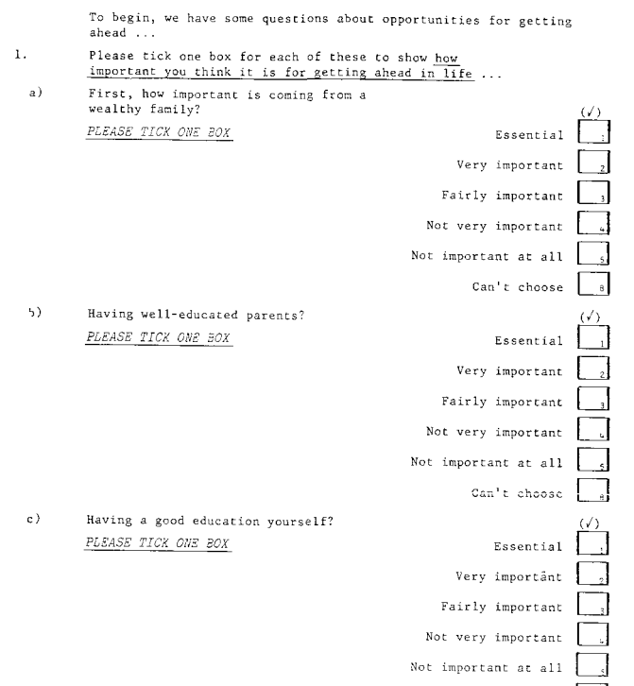
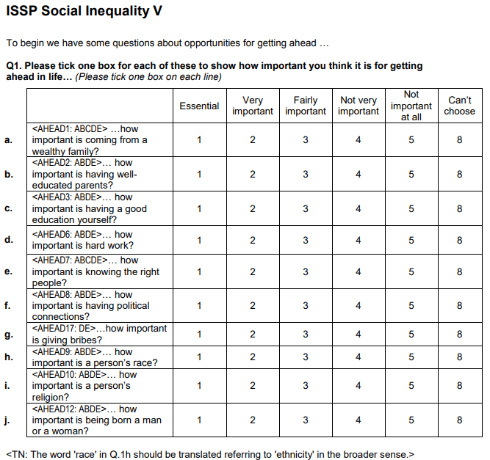
Low-effort responding in surveys in Europe

Slide 5
Low-effort responding in surveys in Europe
Data - ISSP Social Inequality modules from 1987 to 2019
(n = 164 238; largest sample from 2009 - 42 countries & 56 thousand respondents)
5 batteries in each round; 2019: Getting ahead (10 items), Income differences and responsibility (4 items), Perceptions of global inequality (new topic, 3 items), Social conflicts (5 items), Pay criteria (4 items)
Share surveys done as face to face interviews: 1987 - 31%, 1992 - 41%, 1999 - 54%, 2009 - 71%, 2019 - 66%
Outcome variable - straightlining - % of batteries in a survey filled out with single answer (1 if the battery was answered with a single value, 0 otherwise)
Countries
Rest of the world: Argentina, Australia, Canada, Chile, China, Israel, Japan, New Zealand, Philippines, South Africa, South Korea, Suriname, Taiwan, Thailand, Turkey, United States, Venezuela
Western Europe: Austria, Belgium, Cyprus, Denmark, Finland, France, Germany West, Great Britain, Iceland, Italy, Netherlands, North Ireland, Norway, Portugal, Spain, Sweden, Switzerland
Eastern Europe: Bulgaria, Croatia, Czech Republic, Estonia, Germany East, Hungary, Latvia, Lithuania, Poland, Russia, Slovakia, Slovenia, Ukraine

Slide 6
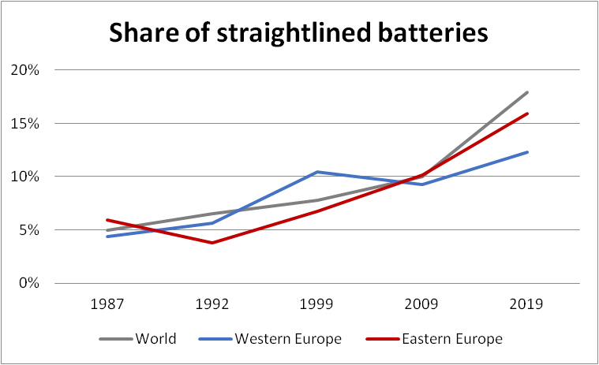
Low-effort responding in surveys in Europe
Overall upward trend in low-effort responding in ISSP Social Inequality module
The overall share of low effort responses has remained stable in Western Europe and increased elsewhere
Increase in low-effort responding since the beginning of the transition is largest in Eastern European countries
How many batteries within a given survey are straightlined - about 15%, below 1 battery per respondent (one survey, 5 batteries)

Slide 7
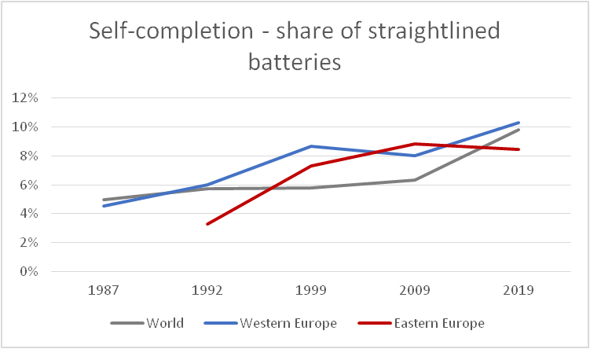
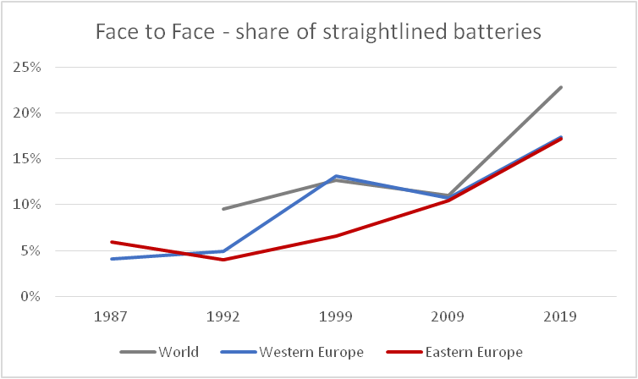
Low-effort responding in surveys in Europe
Self-completion appears to be a superior mode of data collection - at least when straightlining is considered
World in 2019: 5 Face to Face, 3 self-completion, (38% Face to Face overall)
West Europe in 2019: 2 Face to Face, 5 self-completion (36% Face to Face overall)
East Europe in 2019: 6 Face to Face, 1 self-completion (84% Face to Face overall)

Slide 8
Low-effort responding in surveys in Europe
 | 1987 | 1992 | 1999 | 2009 | 2019
Age (years) | 1.086 | 1.133* | 1.009 | 1.009 | 0.985
Gender (male) | 1.000 | 1.002 | 1.000 | 0.999 | 1.000
Education (years) | 1.003 | 1.016* | 0.956* | 0.993* | 0.995*
n | 11 676 | 20 462 | 29 166 | 50 914 | 33 706
Individual level predictors
Age did not predict low-effort responding consistently
Gender did not predict low-effort responding at all
Effect of education was largely supported
Belief that bribes are necessary for getting ahead (not shown) was not supported
Overall, only education and mode of survey administration seem to matter consistently
Post-transition efficacy boost? - maybe

Slide 9
Low-effort responding in surveys in Europe
What’s next?
We are adding more ISSP modules into the dataset and consider other similar surveys (ESS, EVS) to see if the observed patterns hold - to examine the post-transition boost possibility
Examine if country level characteristics may explain the observed patterns better than mode of administration (i.e., corruption, levels of perceived political efficacy)

Slide 10
Questions and answers.
ondrej.buchel@savba.sk
miloslav.bahna@savba.sk

