Slide 1

Institutional trust and climate policy preferences
Evidence from Iceland
Bjarnadóttir, S., Fairbrother, M., Ólafsdóttir, S., and Beckfield, J.
ISSP User conference, 4th of December 2023

Slide 2
The research question
How do political and institutional trust, together and separately, shape public preferences for climate policy in Iceland?

Slide 3
Climate change policies (the dependent variables)
1. Increasing taxes on fossil fuels, such as oil, gas, and coal
  Individual
2. Using public funding for subsidizing renewable energy such as wind and solar power
  The state
3. Just transition
  Vulnerable groups

Slide 4
Political trust and taxation
Taxation usually does not get a lot of support (Rhodes et al., 2017)
  “Push” policies (Steg et al., 2005)
Political trust however..
  ..increases people’s support to support taxation on fossil fuels (Fairbrother et al., 2019; Hammar & Jagers, 2006; Harring, 2018; Harring and Jagers, 2013)
  ..increases people’s support to sacrifice their own income (Bjarnadóttir, 2020)

Slide 5
What about other trust measures and other policies?
“Pull” policies (Steg et al., 2005) and other polices?
Trust in scientists? Trust in the fossil fuel industry? Trust in environmental groups? (Cologna and Siegrist, 2020; Rhodes et al., 2017; Harring, 2018)
Ostrom (1990, 2010) and Rothstein (2005)
  Collective action and social dilemmas– key is trust
  Trust in every actor within society
Institutional trust increases people’s support for the welfare state (Edlund, 2006; Edlund & Lindh, 2013)
  Connected to Just Transition support?

Slide 6
Hypothesis
  Increasing taxes on fossil fuels, such as oil, gas, and coal
+
+
  Subsidizing renewable energy such as wind and solar power
Political trust
+
  Helping and retraining workers who lose their jobs because of new environmental policies
(Measurement of Just Transition)

Slide 7
Hypothesis
  Increasing taxes on fossil fuels, such as oil, gas, and coal
+
+
  Subsidizing renewable energy such as wind and solar power
Institutional trust
+
  Helping and retraining workers who lose their jobs because of new environmental policies
(Measurement of Just Transition)

Slide 8
Data and methods
Part of International Social Survey Programme (ISSP) from 2020
  Some questions are Icelandic specific
Data collected from 15th of December 2020 – 12th of May 2021
  Social Science Research Institute
Linear regression analysis for each climate policy

Slide 9
Table 1. Descriptive statistics
Notes:
Political trust (Parliament)
University research centers
The news media
Business and industry

Slide 10
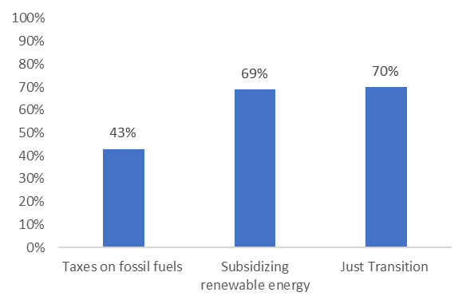
Results
Figure 1. Public support for the three climate policies

Slide 11
Results
Table 2. Summary of the results
Controlled for: female, age, college degree, income quintiles, right political ideology, concerns about the environment and climate belief.
 | Taxes on fossil fuels | Subsidizing renewable energy | Just transition
Political trust | 0.091* | 0.033 | 0.006
Institutional trust | 0.216** | 0.195** | 0.145**
**p<0.01, *p<0.05

Slide 12
Discussion
Research questions: How do political and institutional trust, together and separately, shape public preferences for climate policy in Iceland?
Political trust correlated with public views about taxation on fossil fuels
  Which can be connected to other environmental policy research (Fairbrother et.al., 2019; Harring, 2018)
    Our conclusion: If people perceive a personal cost- political trust matters
Institutional trust correlated with public views about
  Taxation
  Subsidizing renewable energy
  About Just Transition
  4 of 6 hypothesis supported

Slide 13
Final words
Confidence in climate action generally reflect people’s overall beliefs about societal functioning, while attitudes towards taxes depends more narrowly on views of the state
The Icelandic context
  High trust
  Democratic western society
  Renewable energy
Future research
  Just transition support
  Other types of trust measures

Slide 14
References
Bjarnadóttir, S. (2020). Do people behave as their family and friends? The role of social networks for pro-environmental behavior in Iceland. [Master’s thesis, University of Iceland]. http://hdl.handle.net/1946/36982
Cologna, V., and Siegrist, M. (2020). The role of trust for climate change mitigation and adaption behaviour: A meta-analysis. Journal of Environmental Psychology, 69, 101428. https://doi.org/10.1016/j.jenvp.2020.101428
Edlund, J. (2006). Trust in the Capability of the Welfare State and General Welfare State Support: Sweden 1997-2002. Acta Sociologica, 49(4), 395-417. https://doi.org/10.1177/0001699306071681
Edlund, J., & Lindh, A. (2013). Institutional trust and welfare state support: on the role of trust in market institutions. Journal of Public Policy, 33(3), 295-317. https://doi.org/10.1017/s0143814x13000160
Hammar, H., & Jagers, S. C. (2006). Can trust in politicians explain individuals' support for climate policy? The case of CO2 tax. Climate Policy, 5(6), 613-625. https://doi.org/10.1080/14693062.2006.9685582
Harring, N. (2018). Trust and state intervention: Results from a Swedish survey on environmental policy support. Environmental Science & Policy, 82, 1-8. https://doi.org/10.1016/j.envsci.2018.01.002
Harring, Niklas, and Sverker Jagers. 2013. "Should We Trust in Values? Explaining Public Support for Pro-Environmental Taxes." Sustainability 5:210-227. https://doi.org/10.3390/su5010210
Ostrom, Elinor. 2010. "Beyond Markets and States: Polycentric Governance of Complex Economic Systems." American Economic Review 100 (3):641-72. doi: 10.1257/aer.100.3.641.
Ostrom, Elinor 1990. Governing the commons: The evolution of institutions for collective action: Cambridge University Press.
Rhodes, E., Axsen, J., & Jaccard, M. (2017). Exploring Citizen Support for Different Types of Climate Policy. Ecological Economics, 137, 56-69. https://doi.org/10.1016/j.ecolecon.2017.02.027
Rothstein, Bo. 1998. "Just institutions matter." In Just Institutions Matter: The Moral and Political Logic of the Universal Welfare State, 116-43. Cambridge: Cambridge University Press.
Steg, L., Dreijerink, L., & Abrahamse, W. (2005). Factors influencing the acceptability of energy policies: A test of VBN theory. Journal of Environmental Psychology, 25(4), 415-425. https://doi.org/10.1016/j.jenvp.2005.08.003

Slide 15
Thanks for listening!
Questions? Comments?

Slide 16
Appendix
Table A. Correlation matrix for the institutional trust variable

