Slide 1

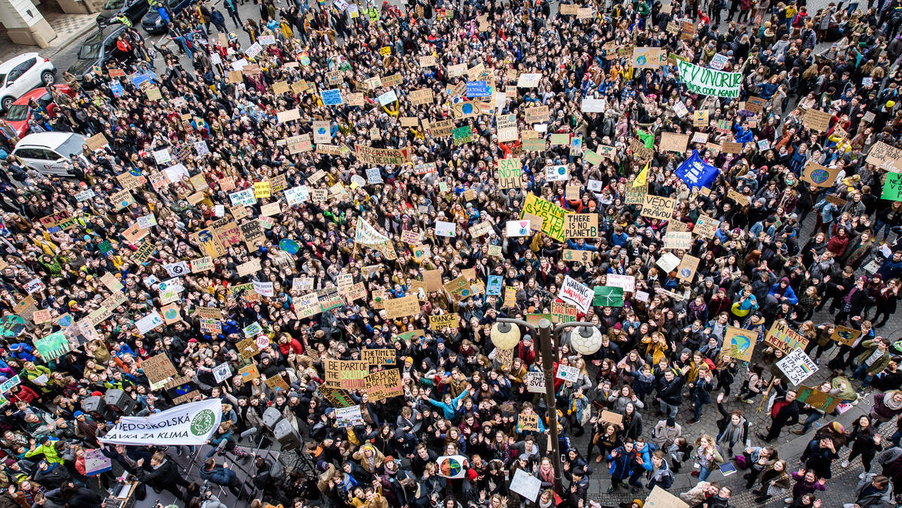
Ladies first?
Gender differences in environmental political participation across countries: The positive effect of gender equality on women’s engagement
Summer Isaacson
Cluster of Excellence “The Politics of Inequality”
University of Konstanz, Germany
summer.isaacson@uni-konstanz.de
Notes:
. 1 Intro; 2 Theory and Lit Reviews; 2.1 Gendered Dimensions of EPP; 2.2 Explaining gender differences in EPP (the micro explanations); 2.3 Gendered opportunity structures

Slide 2
Overview
Research problem & questions
Prior literature & hypotheses 1 & 2
Key concepts
Gendered opportunity structures: Hypotheses 3 & 4
Methods & data
Results & analysis
Concluding thoughts
Summer Isaacson, 2023 December 4

Slide 3
Research problem
The study
  Revisiting the gender gap in political/activist responses to environmental issues.
    The measurement argument: Argues that women’s preferred forms of engagement are overlooked.
    The macro-equality argument: Higher gender equality and socio-economic development allows women to voice their environmental grievances more; therefore cross-country heterogeneity should be emphasized more.
Gender differences in environmental behavior?
    The literature so far reports either no significant gender differences in EPP (Balzekiene & Telesiene, 2012; Briscoea et al., 2019; El Khoury et al., 2022; Hunter et al., 2004; Schumacher, 2014; Trelohan, 2021), or that women engage less in EPP than men do (Tindall et al., 2003; Yang & Wilson, 2023).
    Women dominate “household” environmental behaviors (recycling, reducing), across countries (Balzekiene & Telesiene, 2012; Dzialo, 2017; Kennedy & Kmec, 2018; Tindall et al., 2003).
    1. Are there consistent gender differences across different forms of environmental political participation?
    2. Does a country’s level of gender equality matter more for women’s environmental political participation than for men’s?
Summer Isaacson, 2023 December 4

Slide 4
Individual level explanations: Hypothesis 1 and 2
Gender socialization theory
    How to “do” gender from a young age (Hoominfar, 2019; Dietz et al., 2002; McCright & Xiao, 2014; Zelezny et al., 2000):
    Women: Care, concern for people and nature, rule-abiding, passive, altruism → Avoid confrontation/contentious politics
    More likely to go for the individual, peaceful, less confrontational forms of engagement
    Men: Authoritative, take public space, aggressive, active, leadership → Seek confrontation/contentious politics
    More likely to enjoy collective, confrontational, public forms of engagement
In the literature
    Gender socialization as an explanation behind the “gender gap paradox”: Women consistently report higher environmental concern and household environmentalism, but less EPP (often indexes of petitioning, protesting, membership in groups) (Briscoea et al., 2019; Hunter et al., 2004).
        Hypothesis 1.
        Women will engage more than men in more individual and non-confrontational forms of EPP (boycotting, petitioning).
        Hypothesis 2.
        The female-led gender gap will diminish as the form of EPP gets increasingly collective and confrontational on the scale.
Summer Isaacson, 2023 December 4
Notes:
Gender socialization theory describes how people learn to “do” gender from a very young age, i.e., the internalization of gender norms as they interact with key socialization agents such as family members and other formative social institutions (Hoominfar, 2019). Applied to environmental attitudes and behavior, this approach argues that women are socialized and expected to take on roles as caregivers towards people and nature. This encourages and leads women to develop more of traits like empathy and altruism, and ultimately being more pro-environmental (Briscoea et al., 2019). At the same time, according to this perspective, this process often teaches women to be more passive, rule-abiding, and compassionate, while men are encouraged to take on public and powerful roles, autonomy, and leadership (Coffé & Bolzendahl, 2010). This theoretical approach can thus be used to explain why women would be more concerned and caring for the environment, yet be less likely than men to exercise such attitudes by engaging in collective and confrontational environmental political activism. Classic variables used to capture the presence and influence of socialization on engagement in various environmental behaviors include “feminized” traits such as being concerned for others and for the environment, altruism, and ethical value orientations (Dietz et al., 2002; McCright & Xiao, 2014; Zelezny et al., 2000).

Slide 5
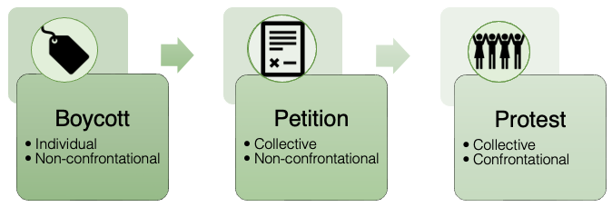
Conceptualizing Environmental Political Participation (EPP)
Concept
  “Voluntary activity or action by people in their role as citizens (rather than e.g., government employees), which specifically concerns government, politics, or the state, in a broad sense” (van Deth, 2016:1), + specifically concerning environmental issues (Levy & Zint, 2013).
  Examples
  Protesting or petitioning for an environmental issue, voting for a green party, environmental political consumption, or donating money to an environmental group.
Individual/collective and non-/confrontational: A scale
    Individual forms favored by women
    Collective forms favored by men
    Non-confrontational forms favored by women
    Confrontational forms favored by men
Figure 1. The EPP scale
Summer Isaacson, 2023 December 4
Notes:
Forms of EPP: Developing a scale
Prior literature often looking at an index of “public” behaviors across countries.
Individual: Not collectively organized but the success of which still relies on the joint effort of others.
Collective: Organized with a shared goal in mind.
Non-confrontational: Conventional, often enjoy better legal protection, an ”insider” form of protest (Dodson, 2015). Favored by women.
Confrontational: Disruptive, imposing costs; economic losses, challenges to authority, and jeopardizing careers (Dodson, 2015). Favored by men.

Slide 6
Gendered opportunity structures: Hypothesis 3 and 4
Political participation and gender inequality
  Women have for a long time been systematically restricted from participating in politics → High cost for women to participate.
  Gender equality is a global issue, but has seen much progress – Much country variation.
  The socio-political cost for women to participate in politics (EPP) decreases as gender equality gets higher.
Gendered opportunity structures
    Variations in opportunity are the most important determinants of variations in both levels and forms of collective action behavior (Koopmans, 1999).
    Opportunities in political systems are likely to affect societal groups differently based on existing inequalities (Snow & Soule, 2010).
Summer Isaacson, 2023 December 4
Notes:
Gendered opportunity structures; “opportunities emerging from changing gender relations and altered views about gender” (McCammon et al, 2001, p. 66).
I.e., gender relations change as gender equality increases (increased female employment or education). The socio-political cost for women to participate in politics (EPP) decreases as gender equality gets higher.

Slide 7
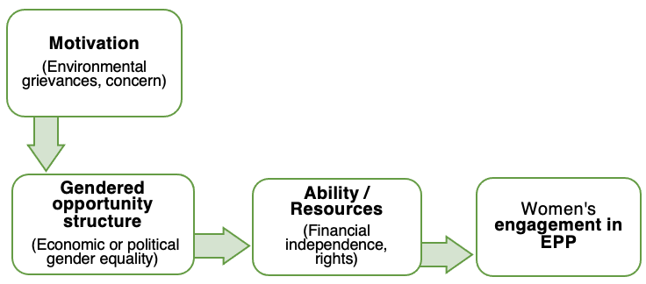
Gendered opportunity structures: Hypothesis 3 and 4
        Hypothesis 3.
    A country having higher levels of economic gender equality will have a positive effect on women’s more collective and confrontational forms of EPP in particular.
        Hypothesis 4.
        A country having higher levels of political gender equality will have a positive effect on women’s more collective and confrontational forms of EPP in particular.
Figure 2. Model of how gender equality can enable women’s EPP
Summer Isaacson, 2023 December 4
Notes:
Gendered opportunity structures; “opportunities emerging from changing gender relations and altered views about gender” (McCammon et al, 2001, p. 66).
I.e., gender relations change as gender equality increases (increased female employment or education). The socio-political cost for women to participate in politics (EPP) decreases as gender equality gets higher.

Slide 8
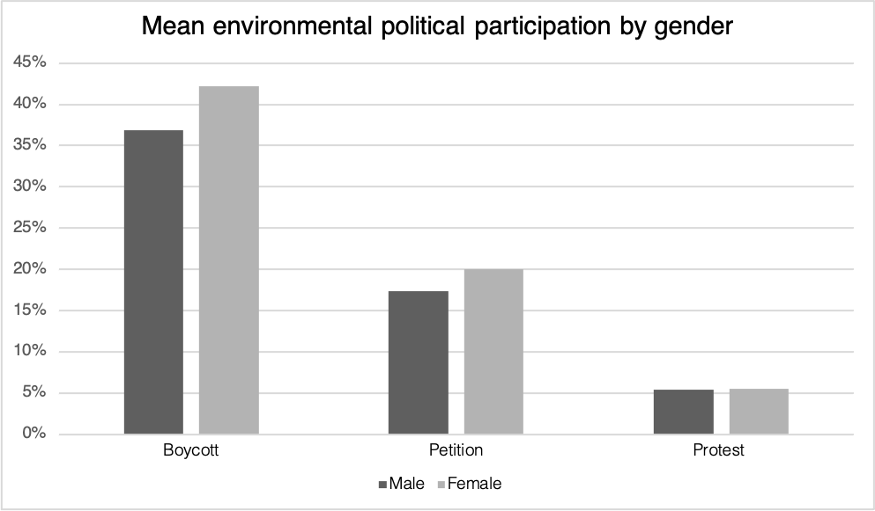
Methods and data
Key dependent variables (binary)
  Boycott
  Petition
  Protest
Key independent variables
    Political gender equality: Women Political Empowerment index (V-Dem institute)
    Economic gender equality: Ratio of female to male labor force participation
    GDP per capita
    Environmental concern
    Environmental ethics
    Environmental grievances (index)
Figure 3. Distribution of dependent variables by gender
Summer Isaacson, 2023 December 4

Slide 9
Methods and data
    Multilevel mixed effects logistic regressions
    Average Marginal Effects (AME) → Margins plots
    All 28 ISSP participant countries.
    44,100 observations → 36,620 (missing removed)
    Cross-level interactions to see effect of gender equality on women’s engagement
    Random slope for the lower-level variable (gender), since gendered effect may vary between countries
Summer Isaacson, 2023 December 4

Slide 10

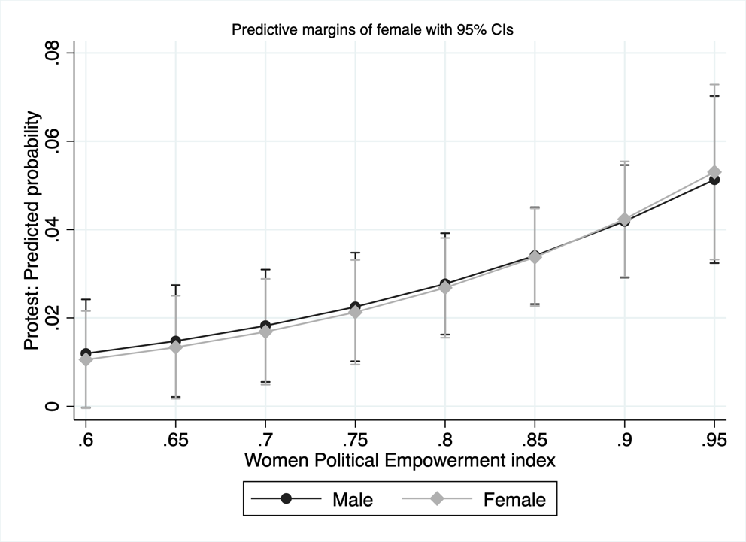
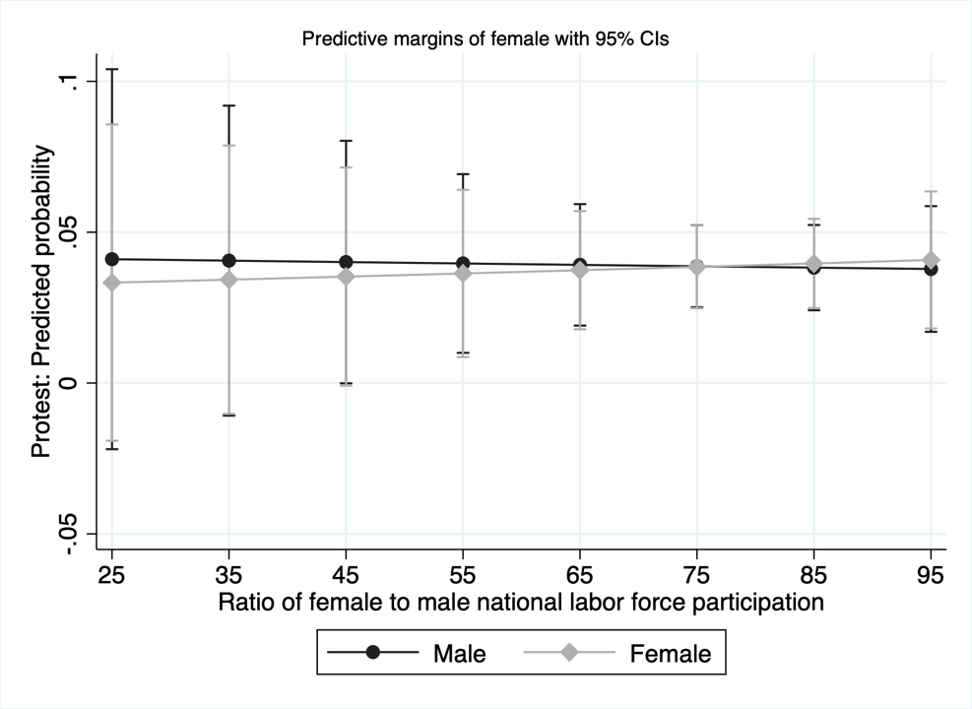
Results: Margins plots - Protest
Figure 4.
Protest: Interaction with FTM LFP
Figure 5.
Protest: Interaction with WPE index
Summer Isaacson, 2023 December 4

Slide 11
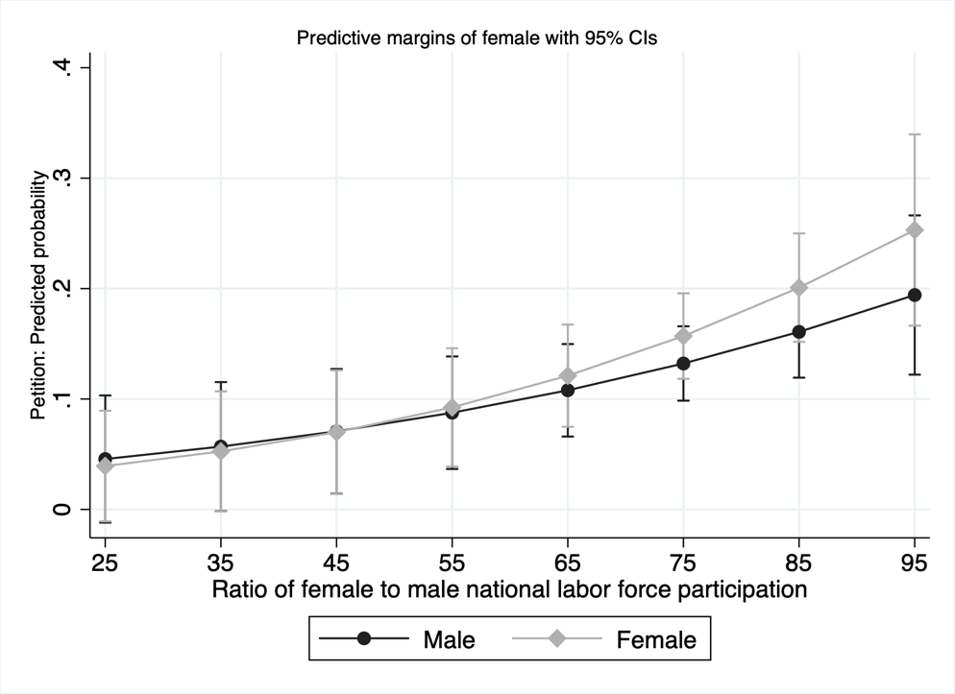
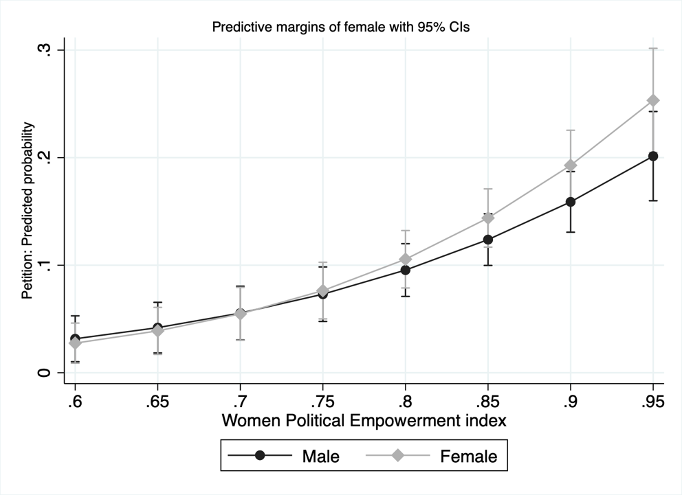
Results: Margins plots - Petition
Figure 6.
Petition: Interaction with FTM LFP
Figure 7.
Petition: Interaction with WPE index
Summer Isaacson, 2023 December 4

Slide 12
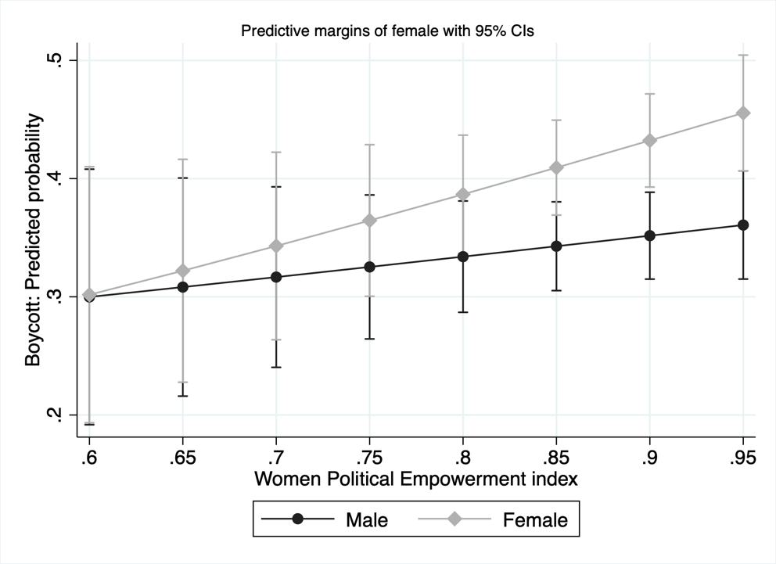
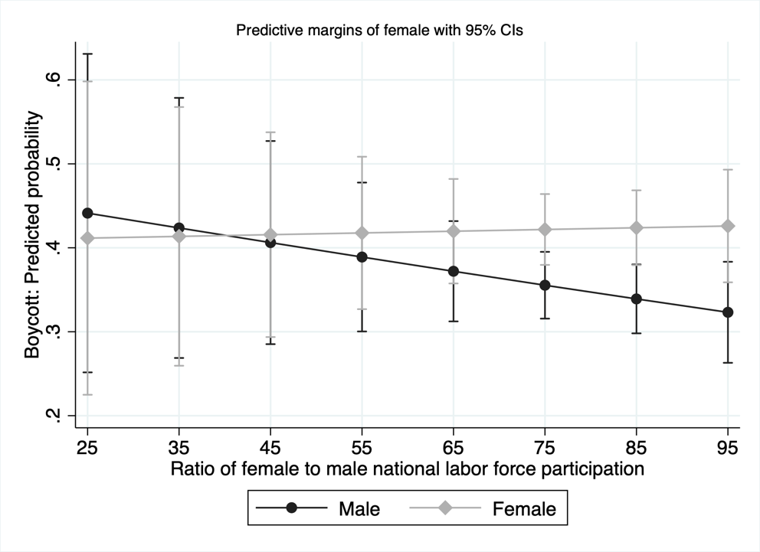
Results: Margins plots - Boycott
Figure 8.
Boycott: Interaction with FTM LFP
Figure 9.
Boycott: Interaction with WPE index
Summer Isaacson, 2023 December 4

Slide 13
Conclusions and take-aways
    Individual level
    Hypothesis 1 and 2 supported: Women do engage more than men, even across countries, but only in certain forms of EPP.
    Environmental concern is consistently a powerful predictor of EPP.
    For boycotting, environmental ethics is more powerful.
    Macro level
    Hypothesis 3 and 4 partly supported: Effect on protest is nonexistent or very weak. Political gender equality has a statistically significant positive relationship with women’s environmental petitioning. Economic gender equality a less powerful predictor. In the logistic regressions, a strong positive relationship with boycotting (not in AME models).
    Women are more likely to engage in EPP in more gender egalitarian countries. However…
    The gender differences in each behavior vary widely from country to country.
    Gender equality has a positive effect on EPP overall for both genders.
    In the case of boycotting, the gender gap appears to come from women being consistent in their engagement and men decreasing as a country increases its economic gender equality.
Summer Isaacson, 2023 December 4

Slide 14
Thank
you!
Summer Isaacson
Cluster of Excellence “The Politics of Inequality”
University of Konstanz, Germany
summer.isaacson@uni-konstanz.de

Slide 15
Appendix: AME

Slide 16
Appendix: AME

Slide 17
Appendix: AME

Slide 18
Appendix: Logistic regressions

Slide 19
Appendix: Logistic regressions

Slide 20
Appendix: Logistic regressions

Slide 21
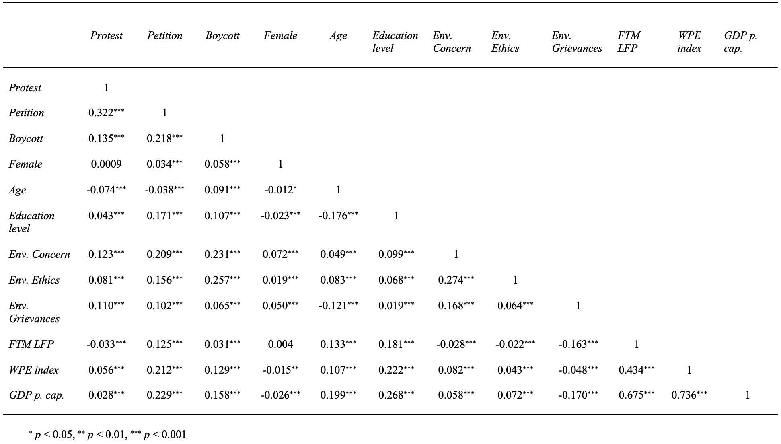
Appendix: Correlation matrix

