Slide 1
Do “environmental losers” pay the price? The role of individual and country vulnerabilities in the relationship between environmental concern and willingness to protect the environment
Marta Moroni and Giulia Dotti Sani
University of Milan

Slide 2
Introduction
“The pace and scale of climate action are insufficient to tackle climate change”
(IPCC, Sixth Assessment Report 2023)
High concern for the environment, high awareness for the issue of climate change
BUT
Low willingness to accept costs to protect the environment and mitigate climate change
(Poortinga et al. 2019; Baiardi , 2022)
(Fairbrother 2022)
Introduction Background Data and Methods Results Conclusions

Slide 3
Research Objectives
Climate and Economic Vulnerabilities
Cross-country comparison
Willingness to accept costs to protect the environment
Environmental Concern
Introduction Background Data and Methods Results Conclusions

Slide 4
Background
Willingness to accept costs to protect the environment
Environmental Concern
Theory of Planned Behavior
Positive but modest effect of environmental concern
Differences according to the specificness of the measure of policy support or willingness to sacrifice
Differences across countries
(Hornsey et al., 2016; Mayerl and Best, 2019; Dienes, 2015)
Introduction Background Data and Methods Results Conclusions

Slide 5
Background
CLIMATE VULNERABILITIES
ECONOMIC VULNERABILITIES
Perceived Experience of extreme weather events
Low Household Income
Country Climate Risk
(Ogunbode et al., 2019; Tvinnereim et al., 2020)
Country GDP
(McConnel, 1997; Franzen and Mayer, 2010; Dienes, 2015;Low and Chow 2013; Franzen, 2003)
Vulnerabilities
Environmental Concern
Willingness to accept costs to protect the environment
Introduction Background Data and Methods Results Conclusions

Slide 6
Hypotheses
WILLINGNESS to protect the environment
WILLINGNESS to protect the environment
High Climate risk Countries
Extreme weather experience
Low GDP countries
Low-income individuals
CONCERN
CONCERN
Individual level
Country level
Introduction Background Data and Methods Results Conclusions

Slide 7
Data and Methods
ISSP 2020 - Environment IV
27 countries worldwide: Austria, Australia, Denmark, Finland, France, Germany, Hungary, Norway, Iceland, Italy, Spain, Switzerland US, Japan, New Zealand, Lithuania, Slovakia, Croatia, Hungary, India, South Korea, Philippines, Russia, Slovenia, South Africa, Thailand, China
Multilevel Regression Models
N: 36 936
Introduction Background Data and Methods Results Conclusions

Slide 8
Dependent variable
Response Options:
Very unwilling
Fairly unwilling
Neither unwilling nor willing
Fairly willing
Very willing
How willing would you be…
To pay much higher prices
To pay much higher taxes
in order to protect the environment?
Average of the two items in a 1-5 scale (from very unwilling to very willing)
→ Willingness to accept costs to protect the environment (Cronbach’s Alpha: 0.83)
Introduction Background Data and Methods Results Conclusions
Notes:
ì

Slide 9
Independent variables
The extent to which the neighborhood was affected by an extreme weather events (such as severe storms, droughts, floods, heat waves, cold snaps, etc.) over the last twelve months: Not at all; To a small extent; To some extent; To a great extent
Income: quintiles
Country’s Climate Risk Assessment:
World Risk Index:
exposure + vulnerability. 0 (low risk) to 100 (high risk)
GDP per capita, PPP
Controls: age, gender, education
Introduction Background Data and Methods Results Conclusions

Slide 10
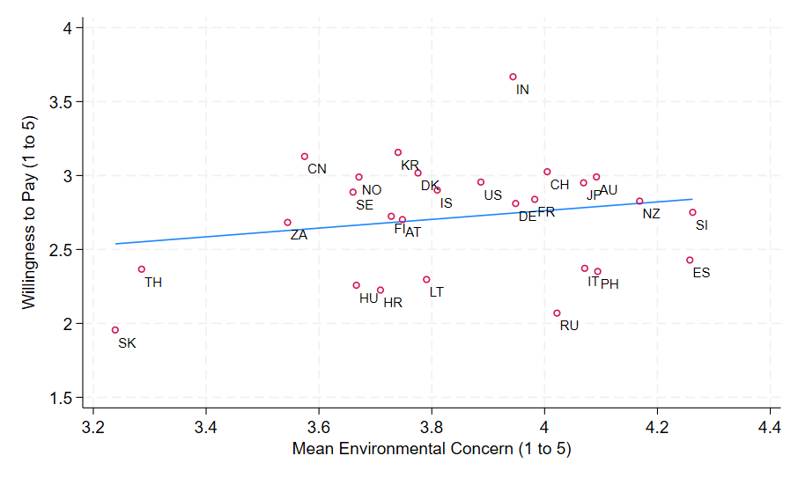
Willingness to pay to protect the environment
Introduction Background Data and Methods Results Conclusions

Slide 11
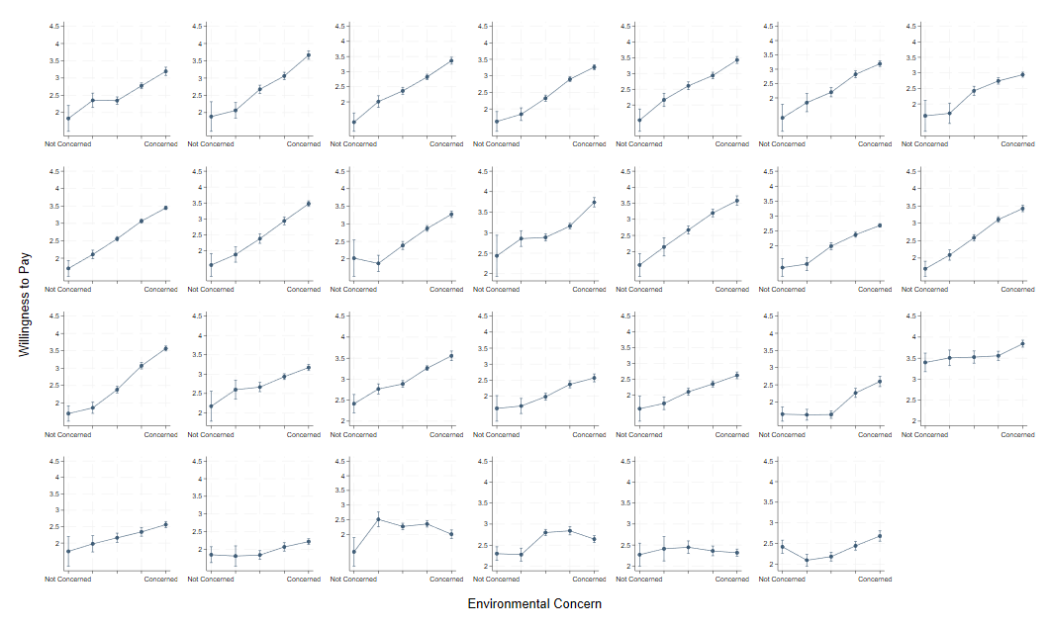
Austria
Denmark
Finland
Germany
Iceland
New Zealand
Slovenia
Results –
Environmental Concern on Willingness to Pay
Country by Country
Switzerland
Australia
France
Korea
Norway
Spain
Sweden
US
Japan
China
Croatia
Lithuania
Slovakia
India
Italy
Russia
Hungary
South Africa
Philippines
Thailand
Note: Predicted mean values at 95% confidence intervals. Predictions control for countries, gender, education, income
Introduction Background Data and Methods Results Conclusions

Slide 12
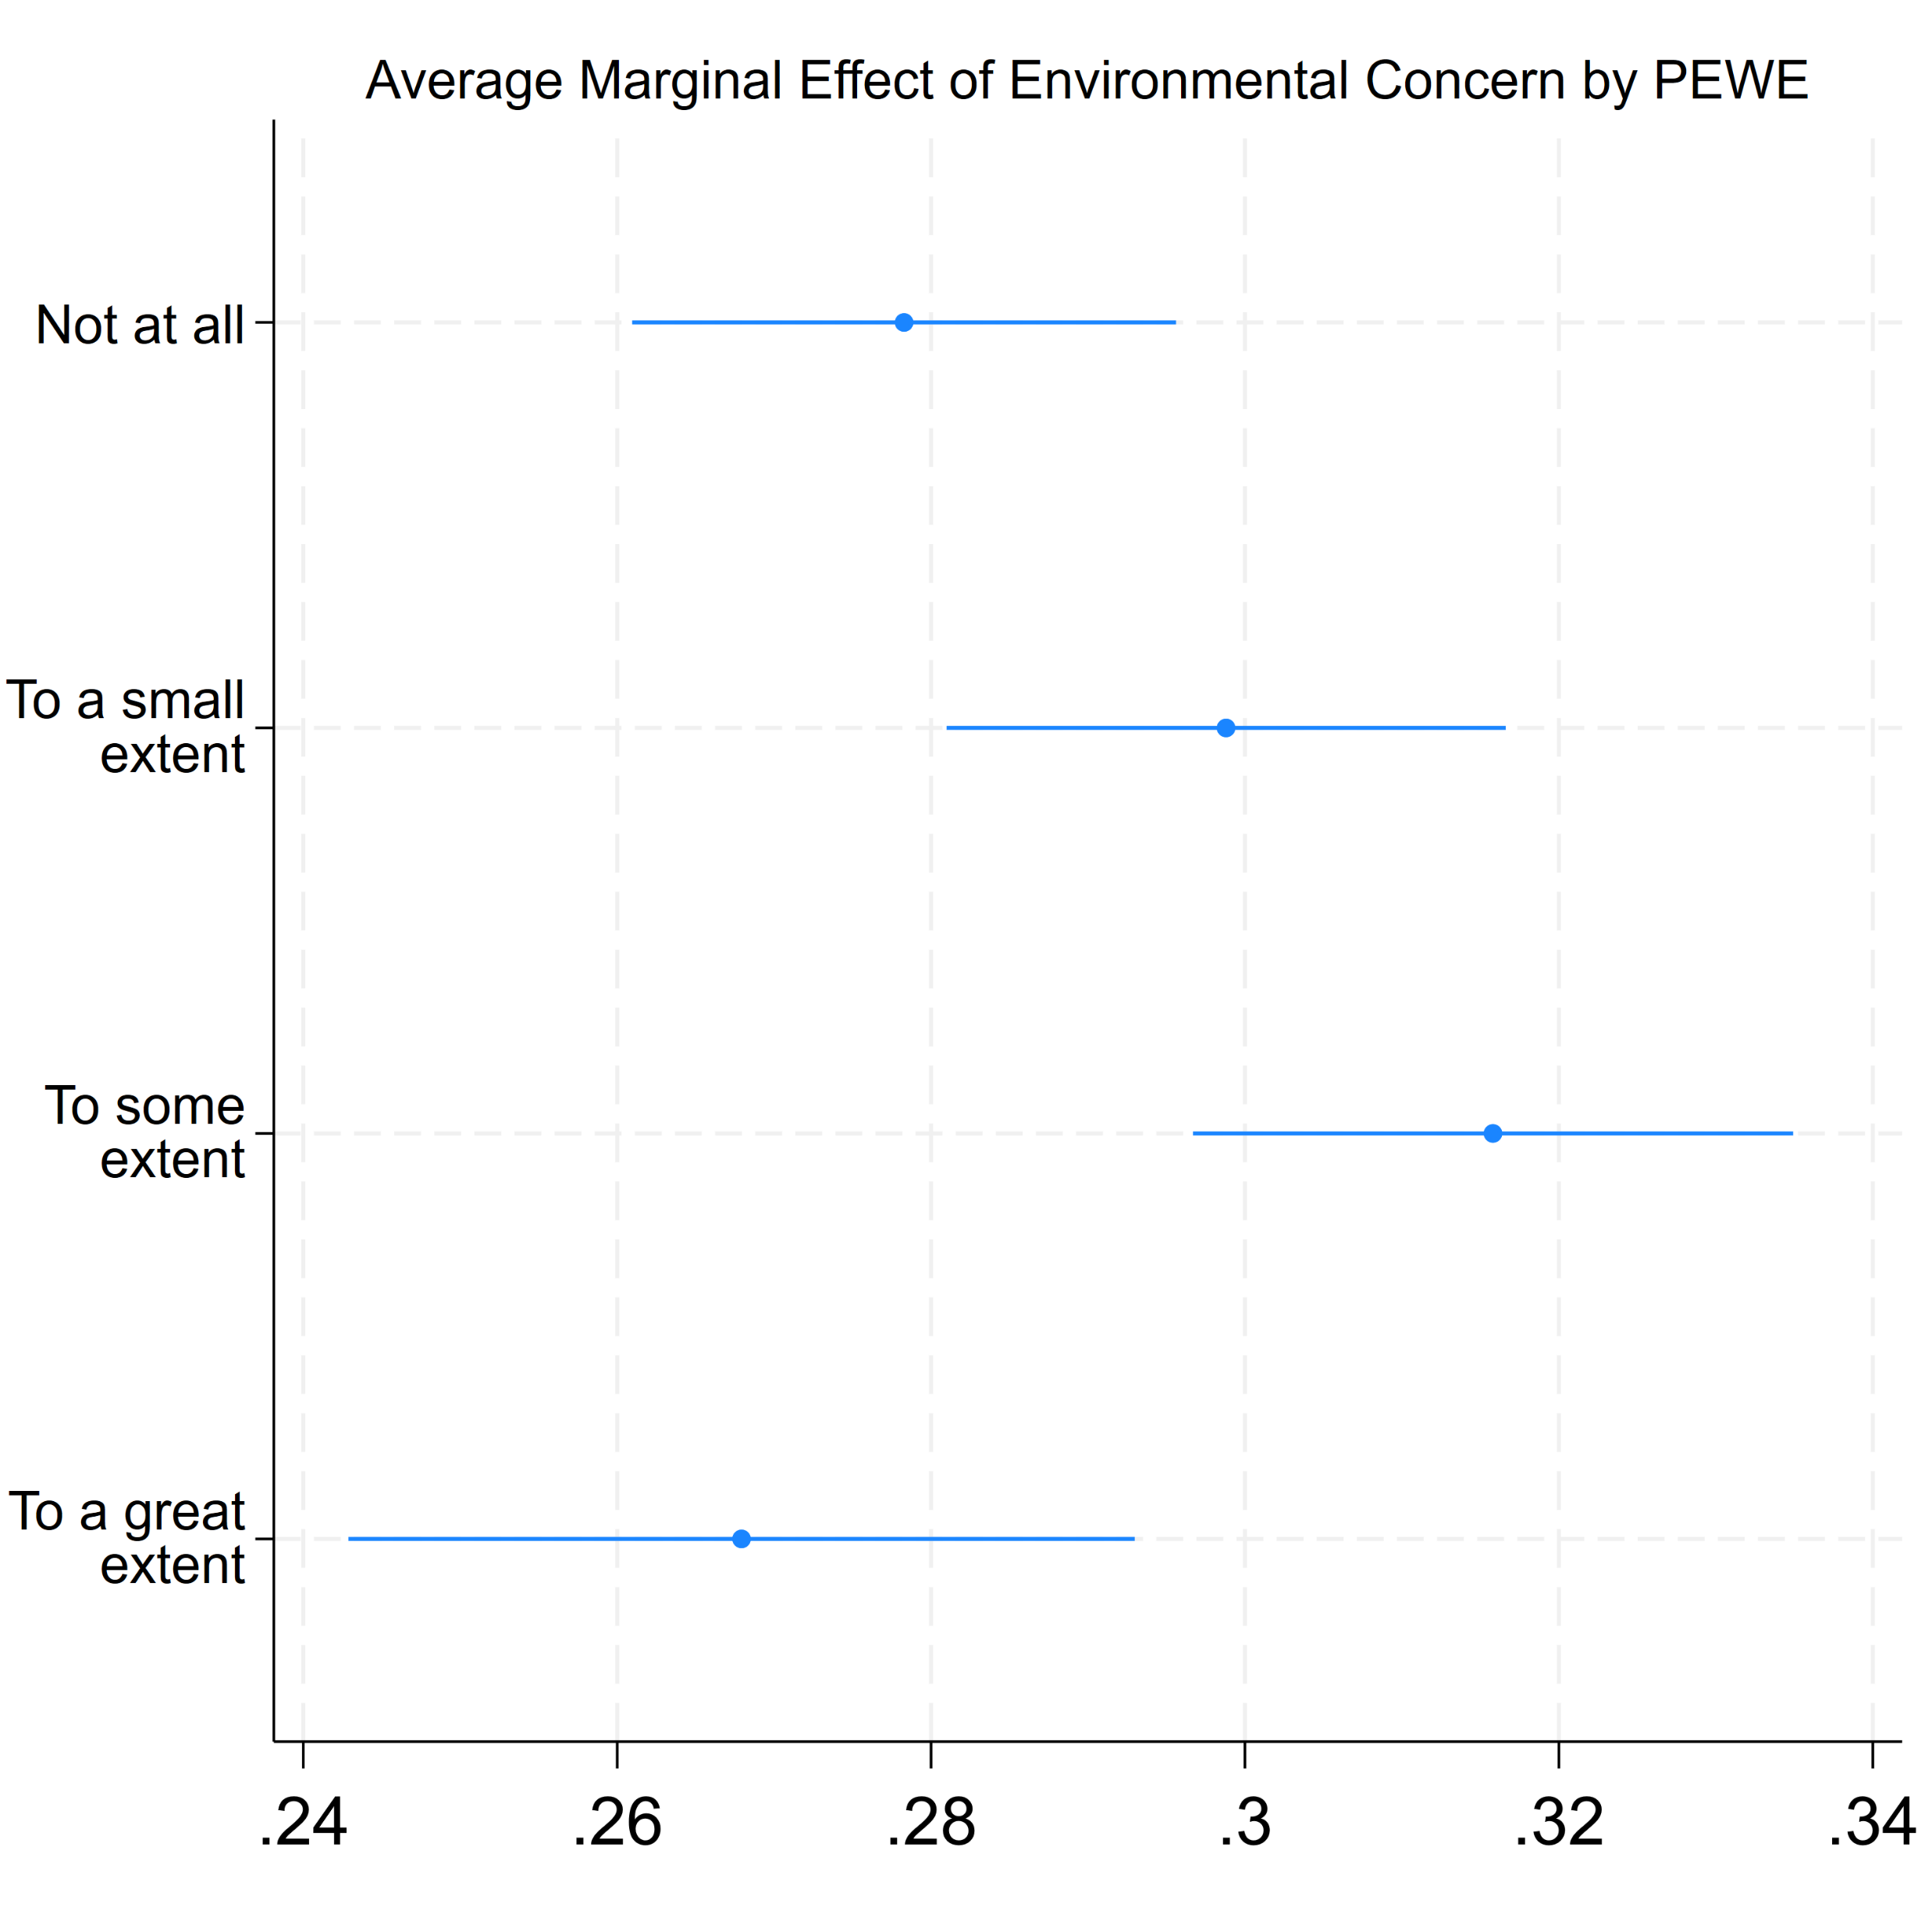
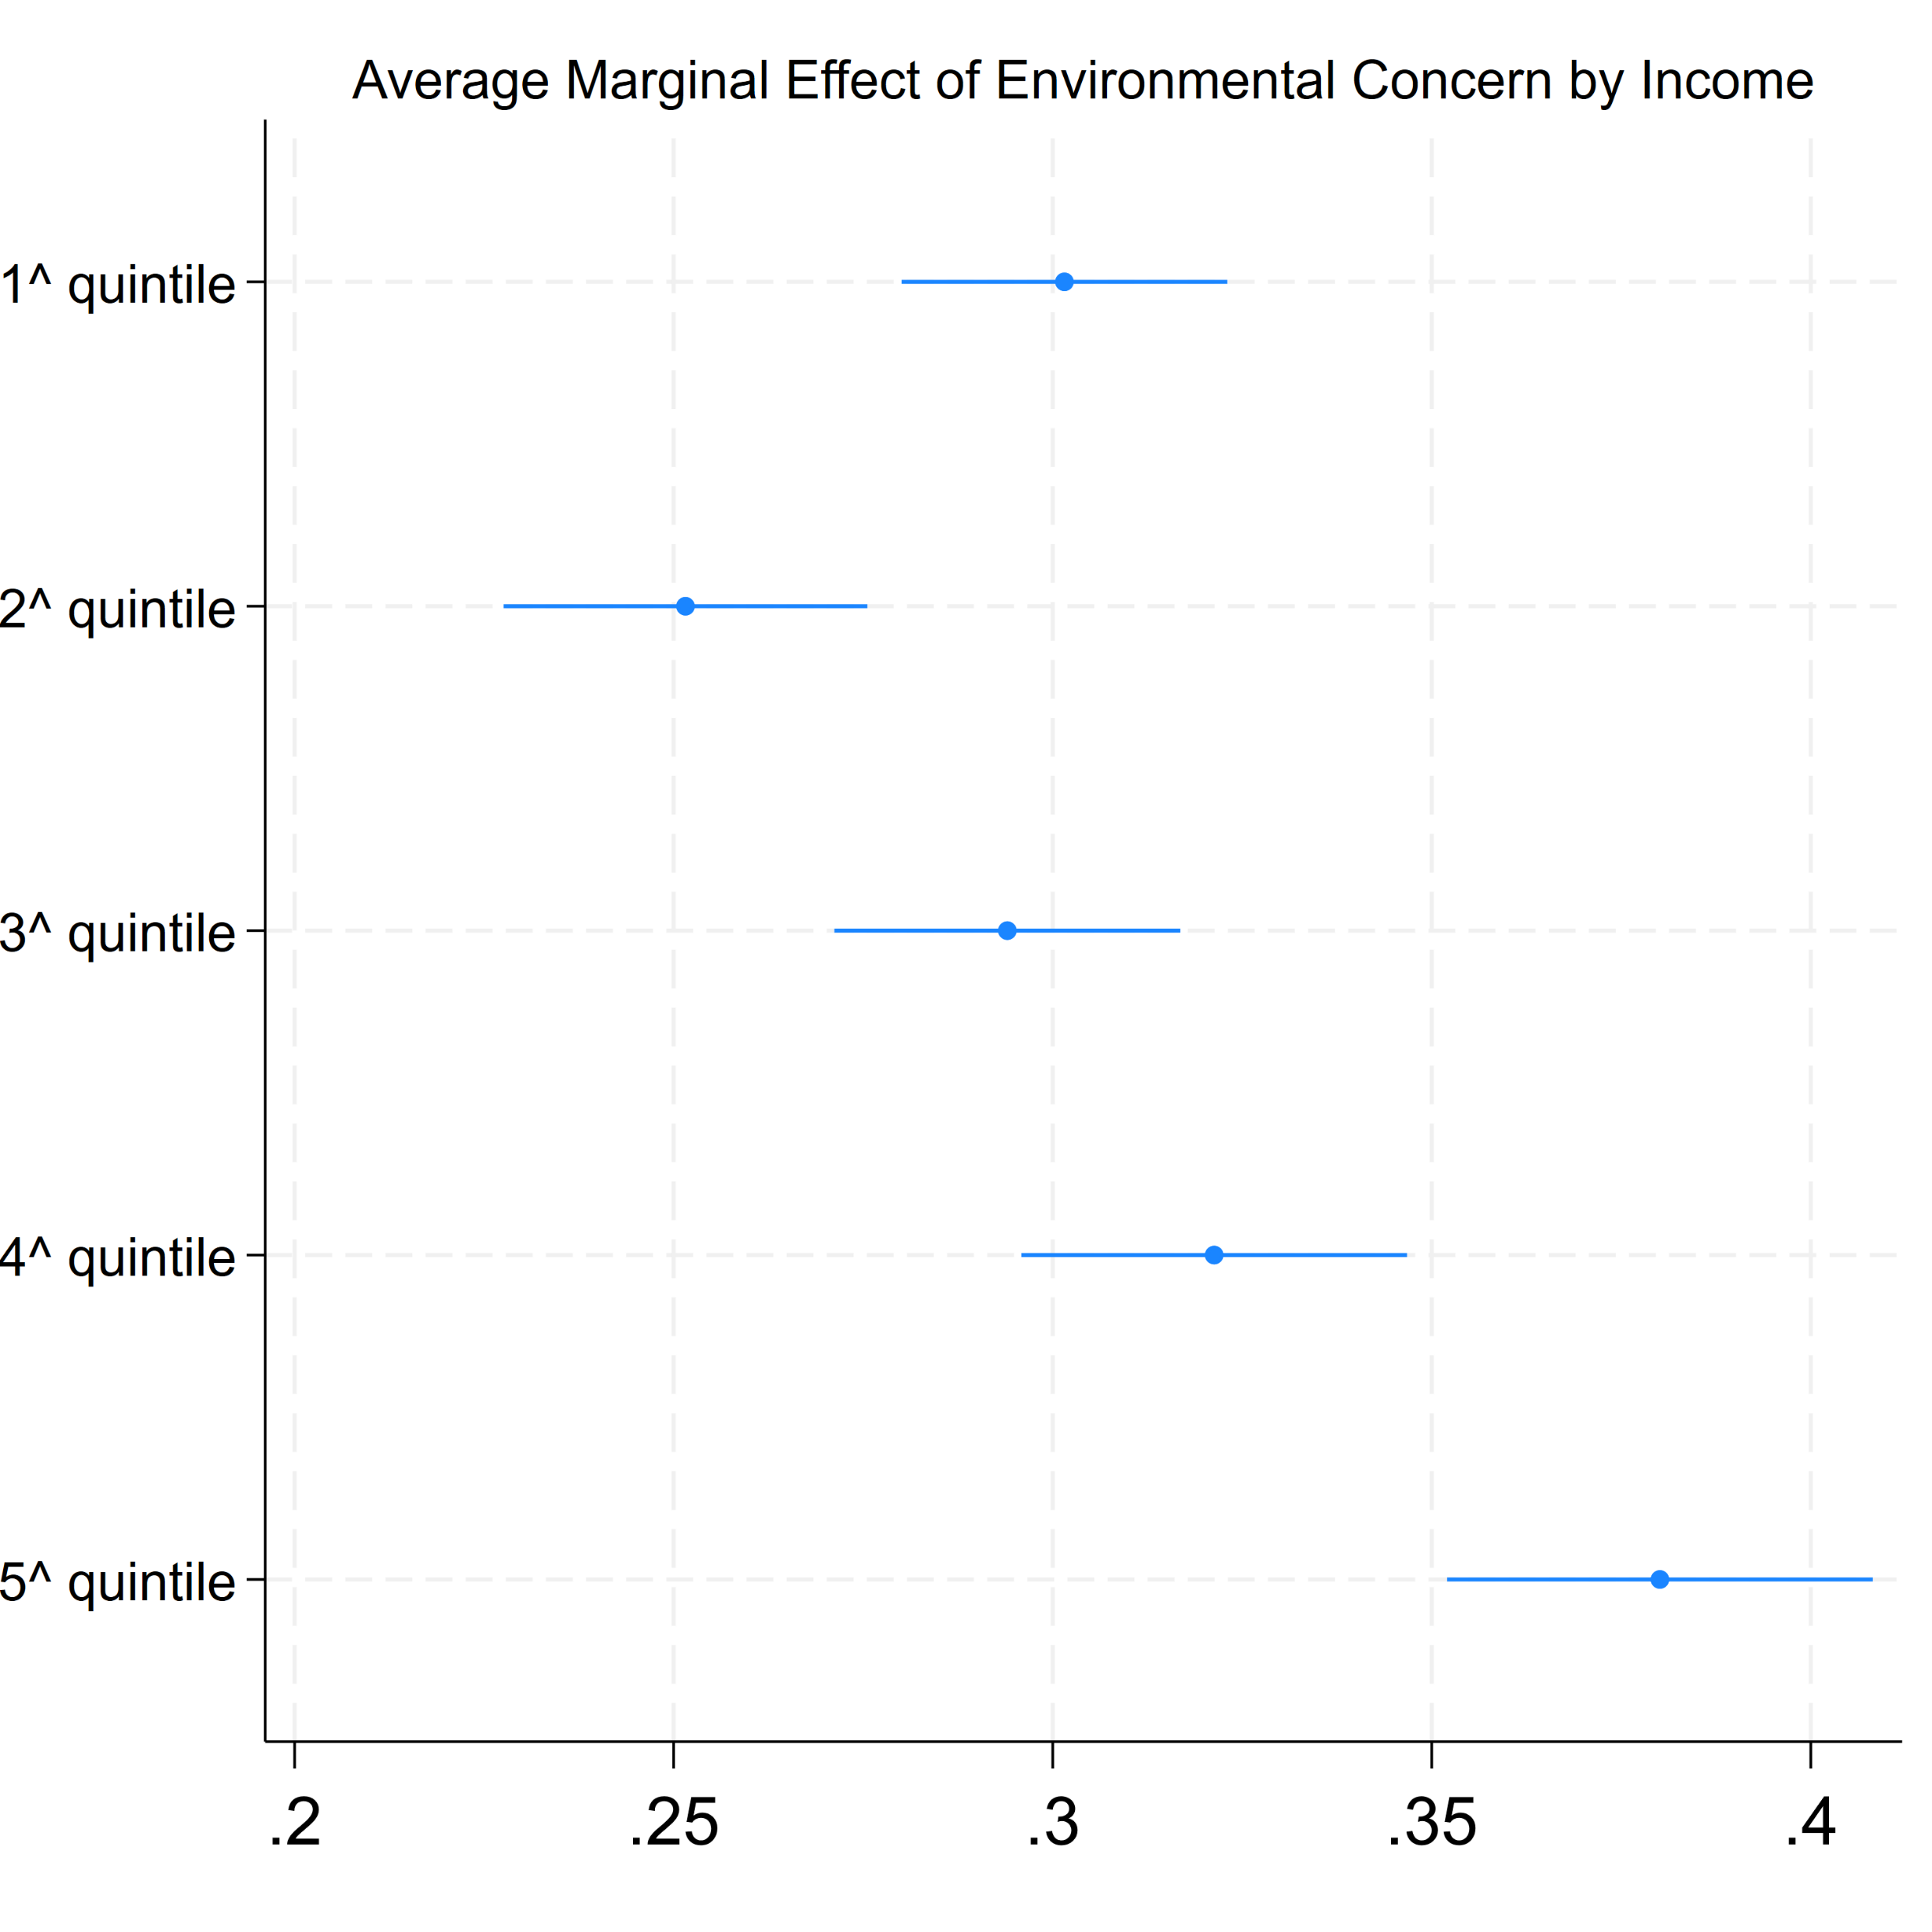
Results –
Moderator effects of Individual vulnerabilities
Note: Fixed effects of Multilevel models. Models include gender, education, age.
Introduction Background Data and Methods Results Conclusions
Notes:
DA CAMBIARE SCALA DELLE X- METTERE STESSO RANGE

Slide 13
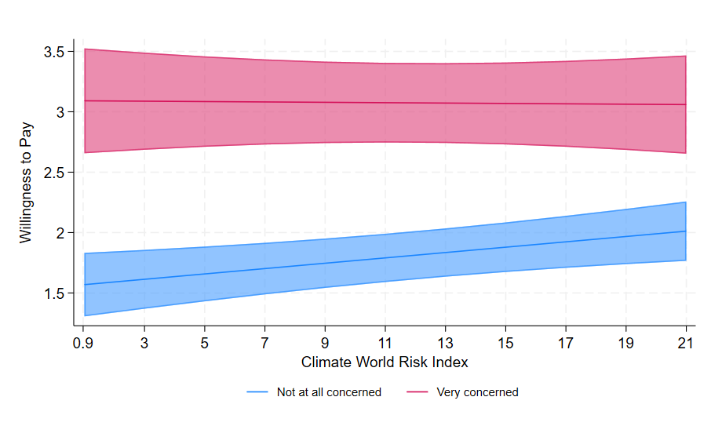
Results –
Moderator effects of Country Climate Risk
Note: Fixed effects of Multilevel random slope models. Models include sex, education, age, household income.
Introduction Background Data and Methods Results Conclusions
Notes:
Moving to the moderator effect of country level vulnerabilities, here we see the predicted levels of willingness to pay for the environment by levels of climate risk of the country for individuals who are concerned and who are not concered for the environment. And can notice that individuals very concerned for the environment have the same levle of willingnsess to pay for the environment regardles the levels of cliamte risk of the country. While individualas who are not concerned for the environment are more willing to pay for it in countries with high levles of climate risk in comparison of those living in low cliamte risk countries.

Slide 14
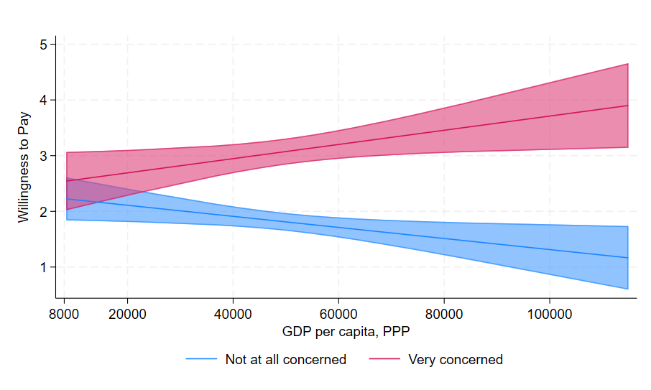
Results –
Moderator effects of GDP
Note: Fixed effects of Multilevel random slope models. Models include sex, education, age, household income.
Introduction Background Data and Methods Results Conclusions
Notes:
Lastly, we looked at the moderator effect of national wealth. As we assumed, being concerned for the environment leads to higher willing to pay in wealthier countries. While it’s less intuitive the effect of those who are nto concered for the environment that are more willing to pay in less wealth countries in comparison to high gdp countries. We are still working on this interpretation and every suggestion is more than welcomed. A possible interpetation may be connected to the differen

Slide 15
Conclusion
Environmental concern → positively influences the willingness to accept costs to protect it.
BUT differences across countries.
Differences in the relationship between environmental concern and willingness to pay seem to be explained in a higher extent by economic vulnerabilities than by climate vulnerabilities.
Introduction Background Data and Methods Results Conclusions

Slide 16
Thank you!
marta.moroni@unimi.it

