Slide 1
Understanding Environmental Skepticism in Central Europe: Evidence from the International Social Survey Programme Environment Module (2020)
2nd ISSP User Conference – Environment
Online Event
4/12/2023
Bruno Šimac, MA, Vladimir Ivanović, MA & Assoc. Prof. Tijana Trako Poljak, PhD
Department of Sociology, Faculty of Humanities and Social Sciences, Zagreb, Croatia
bsimac@ffzg.unizg.hr; vivanovi@ffzg.unizg.hr; ttrako@ffzg.unizg.hr
This research was conducted as part of the project “SECRURAL” funded by Croatian Science Foundation (UIP-2019-04-5257).

Slide 2
Introduction
Environmental skepticism in 6 Central European countries (Austria, Croatia, Germany, Hungary, Slovakia, and Slovenia).
Similarities: geo-political position; shared history; common socio-cultural identity; EU members.
Differences: recent historical/ ideological experiences; different socio-economic situation.

Slide 3
Theoretical background and previous research
Environmental skepticism: “doubt about the authenticity or severity of environmental degradation” (Zhou, 2014).
Reasons for skepticism: deep rooted anthropocentrism; lack of environmental knowledge; distrust (in science and general society).
Implications of skepticism: public doubt in science; passivizing citizens and governments from pro-environmental action; creating a „them vs. us” scenario on environmental stances.
Two main types:
epistemic skepticism – doubts about the status of climate change as a scientific and physical phenomenon;
response skepticism – doubts about the efficacy of action taken to address climate change (Capstick and Pidgeon, 2014).

Slide 4
Previous research – key predictors
Older people (over 65) and men appear to be amongst the most climate change skeptical (Futerra, 2005, DEFRA, 2002, 2007, Schubert and Soane, 2008).
Studies show that less skeptical of climate change are more educated (Zhou, 2014).
Climate change denial and uncertainty are more common in more rural and less prosperous regions (Lübke, 2022).
Lower environmental values relate to higher skepticism (Corbett and Durfee, 2004; Whitmarsh, 2011).
Lack of trust (in general society, media, politicans, science) has also been connected to climate change skepticism (Whitmarsh, 2005; Zhou, 2014).

Slide 5
Aim and research questions
Main research questions:
What are the general environmental skepticism attitudes among 6 observed Central European countries?
What are the principal determinants of environmental skepticism in CE?
Main hypothesis:
H1: Central Europeans will generally exhibit a limited degree of environmental skepticism.
H2: Respondents in Austria and Germany will display significantly lower levels of environmental skepticism compared to their counterparts in Croatia, Hungary, Slovakia, and Slovenia.

Slide 6
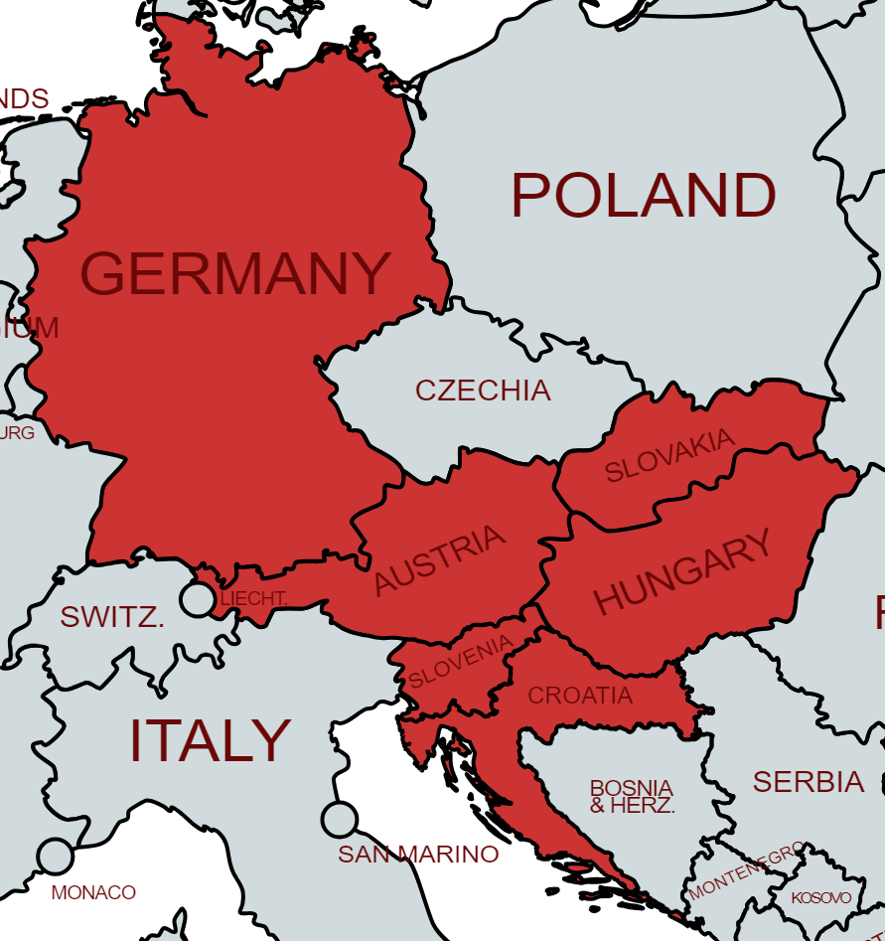
Methodology
For the empirical analysis of environmental attitudes, we rely on ISSP 2020 – Environment IV data.
In this study we included 6 available Central European countries (N=7079) in ISSP country sample:
Austria (N=1261);
Croatia (N=1000);
Germany (N=1702);
Hungary (N=1001);
Slovakia (N=1013);
Slovenia (N=1102).
All data was weighted (WEIGHT).

Slide 7
Methodology
For the purposes of this study, we constructed an Environmental Skepticism Scale (ESS) based on 5 available ISSP items:
Q12a. It is just too difficult for someone like me to do much about the environment.
Q12c. There are more important things to do in life than protect the environment.
Q12d. There is no point in doing what I can for the environment unless others do the same.
Q12e. Many of the claims about environmental threats are exaggerated.
Q12f. I find it hard to know whether the way I live is helpful or harmful to the environment.
Cronbach α=0,753; Min=5; Max=25.
This scale served as a criterion (dependent variable) in our MRA.

Slide 8
Methodology
Analysis also included the following predictors of environmental skepticism:
Respondents’ individual characteristics (gender, age, educational level and settlement type);
Environmental concern (binarized variable Q6. How concerned in environmental issues?);
Opinion on climate change (binarized variable Q8. Opinion on climate change and potential causes?);
Trust in people (binarized variable Q4. Amount of trust in most people);
Institutional trust scale (Q5a; Q5b; Q5c; Q5d – Cronbach α=0,750);
Economic priority over environmental protection scale (Q10b; Q10d; Q10e – Cronbach α=0,605);
Willingness to pay for environment scale (Q11a; Q11b; Q11c – Cronbach α=0,840);
Pro-Environmental activities (Q19a; Q19b);
Pro-Environmental activism (Q20; Q21a; Q21b; Q21c).

Slide 9
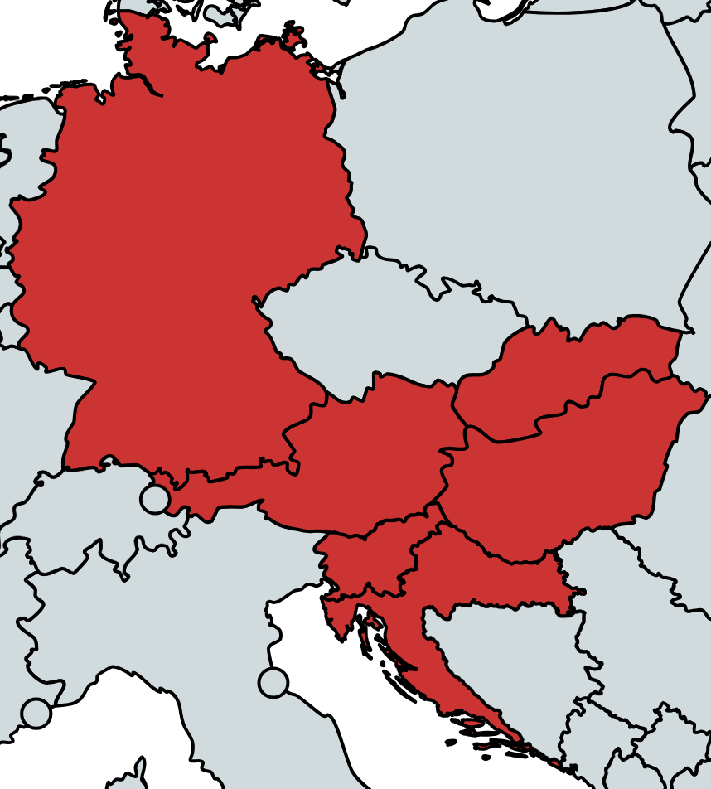
Results – Environmental Skepticism Scale

Slide 10
Results – Environmental Skepticism Scale
In general, Central Europeans tend not to be environmental skeptics.
Mean for all 6 observed CE countries (M=12,82) is below the middle of the theoretical score range which is 15.
However, there are statistically significant country differences:
Respondents from Slovakia (M=14,84) exhibit the significantly highest level of environmental skepticism;
They are followed by Hungarians (M=13,74), Croats (M=13,66) , Slovenians (M=12,48), and Austrians (M=11,99).
Respondents from Germany (M=11,35) report the significantly lowest level of environmental skepticism.
Our first hypothesis
(H1) was confirmed
Our second hypothesis
(H2) was confirmed

Slide 11
Results – MRA
Individual characteristics are not strong predictors of environmental skepticism:
Sex is significant predictor only in Austria and Slovenia (male);
Age is significant predictor only in Croatia and Hungary (older age);
Education level is only significant in Croatia and Slovenia (lower education);
Settlement type is significant in Austria (urban), Croatia and Slovakia (rural).
Environmental concern is a solid predictor in all countries (except Hungary) with those showing lower environmental concern having stronger environmental skepticism attitudes.
Opinion on climate change is a significant, but mostly weak predictor of environmental skepticism (those who don’t believe climate is changing achieve higher results on ESS).

Slide 12
Results – MRA
Trust in people and institutional trust are not significant predictors of environmental skepticism in the majority of countries.
Economic priority over environmental protection is the strongest predictor of environmental skepticism – those who believe that economy should have priority over environmental protection achieve higher results on ESS.
Willingness to pay for environment is a significant and solid predictor in most countries (except Hungary and Slovakia) with those not willing to pay for environment showing stronger environmental skepticism.
Pro-environmental activities are a strong predictor in all countries (those that don’t participate in these activities achieve higher results on ESS).
Pro-environmental activism is mostly a non-significant predictor of ESS (those who are not pro-environmentally active show stronger environmental skepticism).

Slide 13
Conclusion
Environmental skepticism is an important topic to research as its implications are serious for both individual and wider social pro-environmental action.
While previous studies mostly focused on climate change denial, it is only a subgroup of a wider environmental skepticism which should be researched further and in depth.
The fact that there is a generally low level of environment skepticism in Central Europe is encouraging, but some deviations from this and country-specific predictors should be examined further.
Strongest predictors of environmental skepticism are lower environmental concern, economic priority over environmental protection and lower participation in pro-environmental activities.

Slide 14
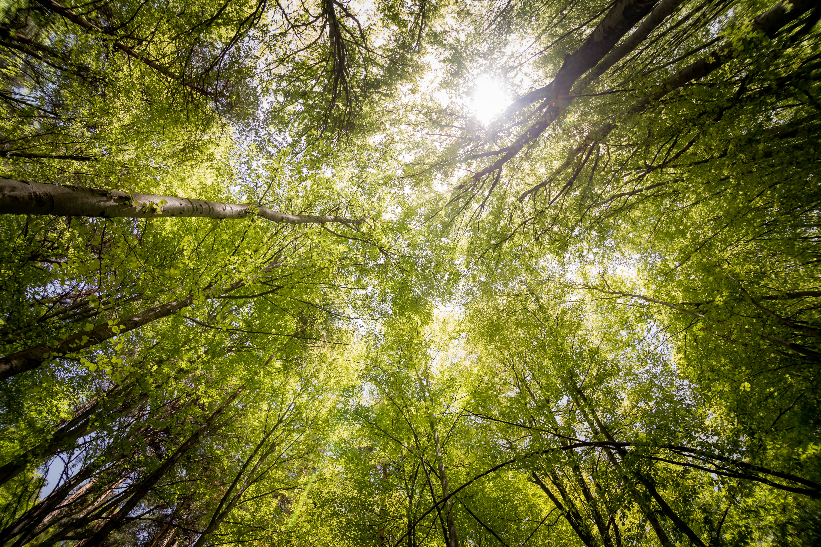
Thank you for your attention!

Slide 15
Appendix
 | AT | HR | DE | HU | SK | SI
 | β
Sex | -0,080** | -0,048 | -0,039 | 0,010 | -0,035 | -0,088**
Age | 0,008 | 0,102** | 0,029 | 0,074* | 0,027 | 0,052
Education level | -0,043 | -0,080** | 0,005 | -0,058 | -0,008 | -0,063*
Settlement type | 0,096** | -0,149** | -0,004 | 0,008 | -0,096** | -0,022
Environmental concern | -0,135** | -0,103** | -0,134** | -0,043 | -0,261** | -0,097**
Opinion on climate change | -0,074** | -0,006 | -0,090** | -0,187** | 0,036 | -0,072*
Trust in people | -0,036 | -0,048 | -0,021 | 0,096** | 0,003 | -0,014
Institutional trust scale | -0,063* | -0,002 | -0,063* | -0,032 | 0,010 | -0,040
Economic priority over environmental protection scale | 0,375** | 0,310** | 0,366** | 0,258** | 0,265** | 0,381**
Willingness to pay for environment scale | -0,052* | -0,106** | -0,110** | -0,015 | 0,007 | -0,142**
Pro-Environmental activities | -0,304** | -0,194** | -0,172** | -0,137** | -0,257** | -0,115**
Pro-Environmental activism | -0,067** | -0,028 | -0,076 | -0,023 | -0,164** | -0,048
R² | 0,493 | 0,328 | 0,420 | 0,164 | 0,403 | 0,342
Note: *p<0,05; **p<0,01

