Slide 1
Cross-country and cross-time comparisons using multilevel models
Bart Meuleman, KU Leuven (Belgium)
ISSP Methods Webinar, 10/04/2025

Slide 2

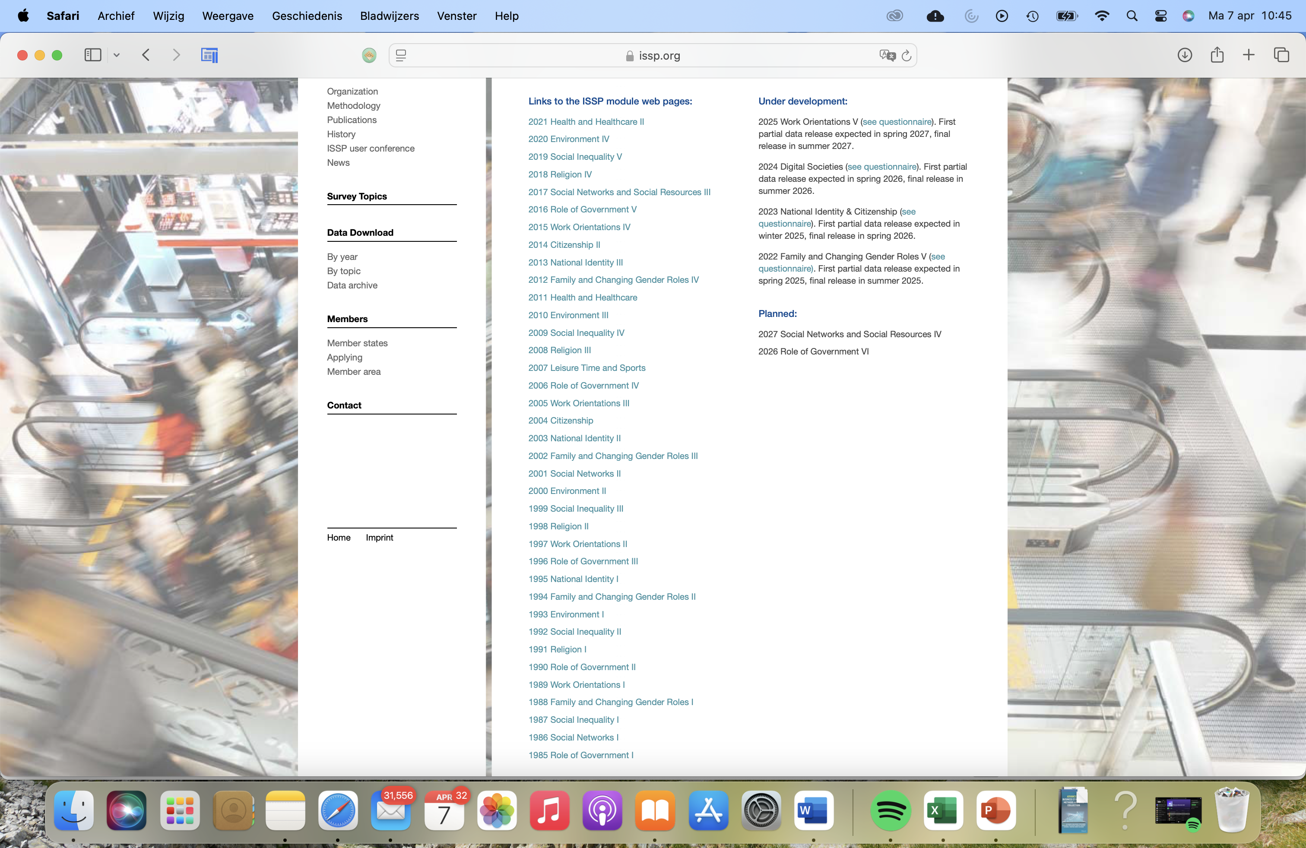
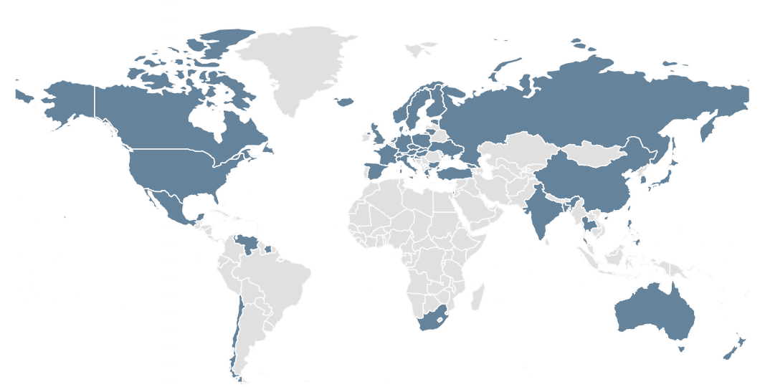

Slide 3
The purpose of comparative research
Investigate variation in individual preferences and behaviour across contexts
Epistemological approaches:
Societal approach: contextualizing differences
Decompose the specific context into variables that are linked to individuals’ preferences and behaviour
Universalist
Societal
Culturalist
Focus on similarities across contexts
General laws that apply across contexts
Focus on the particulars of contexts
Social processes are understood as unique, socio-historical configurations

Slide 4
Comparative research designs
Variation across time and place (assuming observational data)
 |  | One country | Multiple countries
One time point |  | 1 | 2
Multiple time points | Repeated cross-sections | 3 | 4
 | Panel data | 5 | 6

Slide 5
This webinar
Aim: How to analyse cross-national repeated cross-sectional data?
Individual-level dependent variable
20+ units of place (here: countries)
Minimum of 3 time points
Conceptual issue 1: Data structures & levels
Conceptual issue 2: Within vs. between effects
Statistical approach: Societal growth curve models
Application of multilevel regression models
2 illustrations: comparing evolutions of perceived ethnic threat

Slide 6
Issue 1: Data structures & levels
Cross-national repeated cross-sectional data:
Different levels of analysis: individual vs. context (place vs. time)
Individuals (lower level) are nested within contexts (higher level)
Countries
Time points (country-years)
Individuals

Slide 7
Decomposition of variance across levels
Perceived threat
T1 T2 T3

Slide 8
Decomposition of variance across levels
Perceived threat
Level 3: differences between countries
T1 T2 T3

Slide 9
Decomposition of variance across levels
Perceived threat
Level 2: differences between years within countries
T1 T2 T3

Slide 10
Decomposition of variance across levels
Perceived threat
Level 1: differences between individuals within country-years
T1 T2 T3

Slide 11
Issue 1: Data structures and levels
Cross-national repeated cross-sectional data can be considered as a 3-level structure
Individuals nested in country-years nested in countries
The variance of individual-level variables can be decomposed into 3 sources of variation
Variation between countries
Variation between years within countries
Variation between individuals within country-years

Slide 12
Issue 2: Within vs. between effects
Variables & levels
Global / intrinsic variables: variables at their ‘natural level’
Structural variables: aggregated from sub-units at a lower level
Level | Var 1
Country
Country-year
Individual | Education
Var 2
Unemployment rate
Var 3
Political system
AGGREGATION

Slide 13
Issue 2: Within vs. between effects
Intrinsic variables explain the variance component at their corresponding level
Level | Var 1
Country
Country-year
Individual | Education
Var 2
Unemployment rate
Var 3
Political system
Dependent var.
Differences between countries
Differences between country-years
Differences between individuals

Slide 14
Issue 2: Within vs. between effects
Intrinsic variables explain the variance component at their corresponding level
Aggregated versions of lower-level components explain higher-level variance components
Level | Var 1
Country
Country-year | Average education
Individual | Education
Dependent var.
Differences between countries
Differences between country-years
Differences between individuals
BETWEEN EFFECT
WITHIN EFFECT

Slide 15
Issue 2: Within vs. between effects
Within effects can differ from between effects!
Example 1 (Curran & Bauer, 2011): Is physical exercise good for you?
Individuals are more likely to experience heart attack while the are exercising
Individuals who exercise frequently are less like to experience heart attack
Average amount of exercise
-
P(heart attack) of individual
individual
time point
Exercise at time point
+
P(heart attack) at time point
Notes:
15

Slide 16
Issue 2: Within vs. between effects
Example 2: Religiosity & alternative medicine use across countries
Average AM use
-
Average religiosity
country
Alternative medicine use
individual
AM use
+
Religiosity
religiosity
Notes:
16

Slide 17
Issue 2: Within vs. between effects
One and the same predictor can have different effects at different levels (within vs. between)
Well-known issue (ecological fallacy, Simpson’s paradox,…)
The effects at different levels refer to different theoretical mechanisms
E.g. within country effects are more likely to support a causal interpretation compared to between effects
Yet, many comparative analysis fail to distinguish between the effects at different levels

Slide 18
Disentangling multilevel effects further…
Between effect
Perceived threat
Total effect
Within effect
Feelings of deprivation

Slide 19

Disentangling multilevel effects further…
The between effect consists of two components
Perceived threat
Context effect
Composition effect (= within-effect reflected at higher level)
Between = composition + context
Context = Between - within

Slide 20
Disentangling multilevel effects further…
Perceived threat
Between = within
No context effect, only composition
Feelings of deprivation

Slide 21
Disentangling multilevel effects further…
Perceived threat
No within effect
Between effect is purely due to context
Feelings of deprivation

Slide 22

Statistical approach: multilevel modelling
Starting point: single-level, linear regression model
$$Y_{i}=β_{0}+β_{1}X_{i}+ε_{i}$$
$$with{ ε}_{i}\sim N(0,σ_{ε}^{2})$$
Error of prediction for individual i
Perceived threat of individual i
Residual variation of individuals
Average perceived threat when deprivation = 0
Effect of a one-unit increase in deprivation
Notes:
22

Slide 23
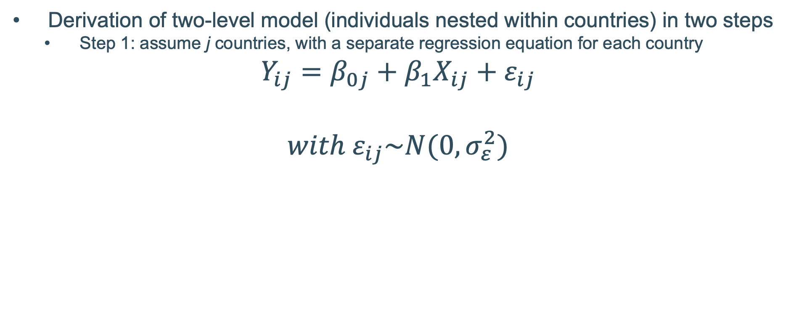
The basics of multilevel modelling
Derivation of two-level model (individuals nested within countries) in two steps
Step 1: assume j countries, with a separate regression equation for each country
$$Y_{ij}=β_{0j}+β_{1}X_{ij}+ε_{ij}$$
$$with{ ε}_{ij}\sim N(0,σ_{ε}^{2})$$
Error of prediction for individual i in country j
Perceived threat of individual i in country j
Residual variation of individuals within a country
Average perceived threat for country j when deprivation = 0
Effect of a one-unit increase in deprivation
Notes:
23

Slide 24
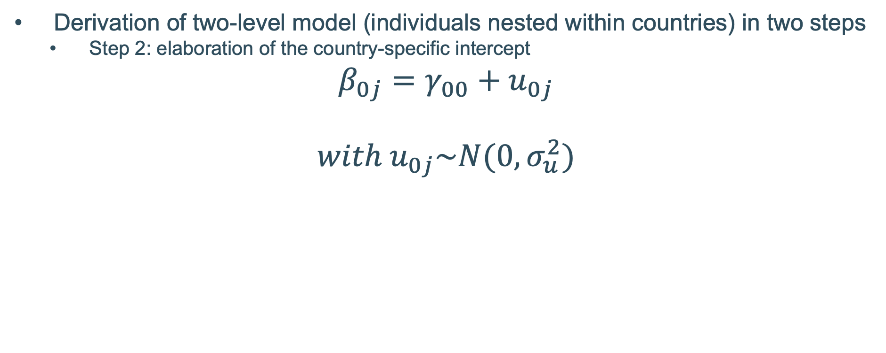
The basics of multilevel modelling
Derivation of two-level model (individuals nested within countries) in two steps
Step 2: elaboration of the country-specific intercept
$$β_{0j}=γ_{00}+u_{0j}$$
$$with{ u}_{0j}\sim N(0,σ_{u}^{2})$$
Differential level of perceived threat in country j
Average perceived threat in country j
Variation of country averages
Average perceived threat over all countries
Notes:
24

Slide 25
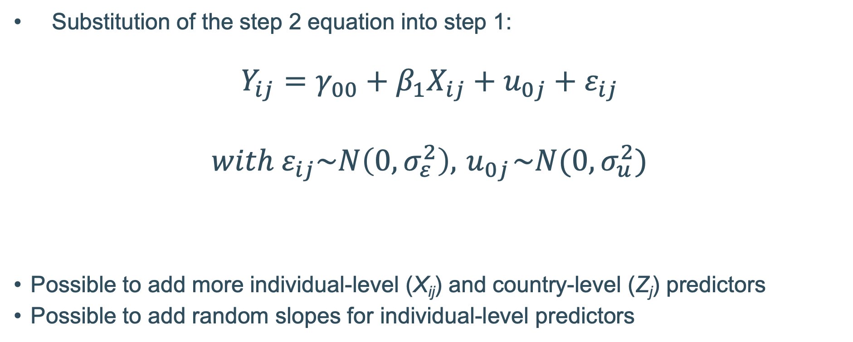
The basics of multilevel modelling
Substitution of the step 2 equation into step 1:
$$Y_{ij}=γ_{00}+β_{1}X_{ij}+u_{0j}+ε_{ij}$$
$$with{ ε}_{ij}\sim N\left(0,σ_{ε}^{2}\right), { u}_{0j}\sim N(0,σ_{u}^{2})$$
Possible to add more individual-level (X_{ij}) and country-level (Z_{j}) predictors
Possible to add random slopes for individual-level predictors
FIXED EFFECTS
RANDOM EFFECTS
Notes:
25

Slide 26

The basics of multilevel modeling
$$Y_{ij}=γ_{00}+β_{1}X_{ij}+u_{0j}+ε_{ij}$$
Perceived threat
1
Relative deprivation
Notes:
26

Slide 27
The basics of multilevel modelling
The dependent variable is partitioned in two orthogonal components:
Variance partitioning:
Intra-class correlation:
Proportion of variance at the highest level
Correlation between pairs of citizens from the same country
—
Notes:
27

Slide 28
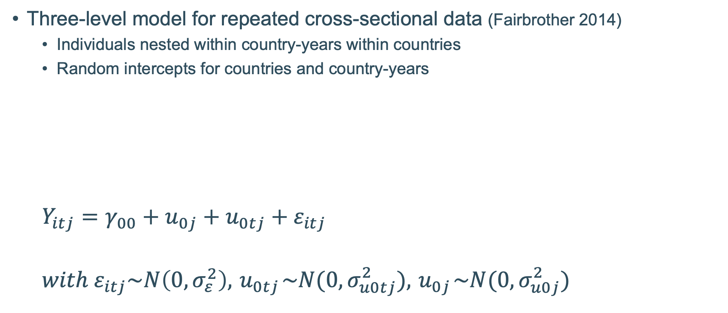
Societal growth curve models
Three-level model for repeated cross-sectional data (Fairbrother 2014)
Individuals nested within country-years within countries
Random intercepts for countries and country-years
$$Y_{itj}=γ_{00}+u_{0j}+u_{0tj}+ε_{itj}$$
$$with{ ε}_{itj}\sim N\left(0,σ_{ε}^{2}\right), { u}_{0tj}\sim N(0,σ_{u0tj}^{2}), { u}_{0j}\sim N(0,σ_{u0j}^{2})$$
Countries
Time points (country-years)
Individuals

Slide 29
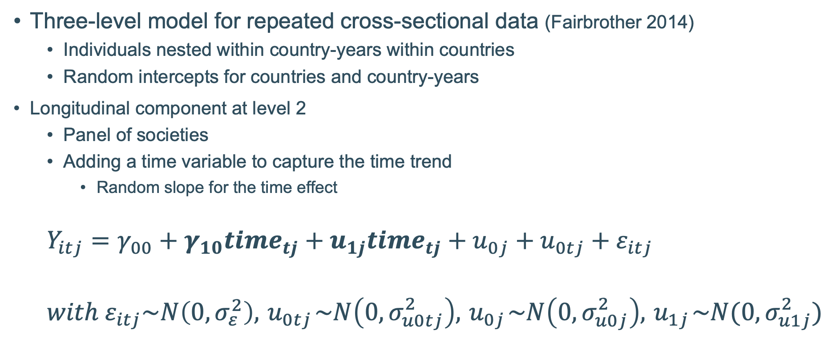
Societal growth curve models
Three-level model for repeated cross-sectional data (Fairbrother 2014)
Individuals nested within country-years within countries
Random intercepts for countries and country-years
Longitudinal component at level 2
Panel of societies
Adding a time variable to capture the time trend
Random slope for the time effect
$$Y_{itj}=γ_{00}+γ_{10}{time}_{tj}+u_{1j}{time}_{tj}+u_{0j}+u_{0tj}+ε_{itj}$$
$$with{ ε}_{itj}\sim N\left(0,σ_{ε}^{2}\right), { u}_{0tj}\sim N\left(0,σ_{u0tj}^{2}\right), { u}_{0j}\sim N\left(0,σ_{u0j}^{2}\right),{ u}_{1j}\sim N(0,σ_{u1j}^{2})$$
Countries
Time points (country-years)
Individuals

Slide 30
Societal growth curve models
Predictors at the various levels can be added
Individual-level
Country-year level (time-varying country characteristics)
Country level (time-invariant country characteristics)
How to disentangle effects at different levels?
Decompose independent variable Z_{tj} into…
Stable country mean: Z_{j.} Captures the between effect
Year-specific deviation from that mean: (Z_{tj} – Z_{j}). Captures the within effect
Include both components in the model
(the differences between both effects gives the context effect)

Slide 31
Illustration 1: perceived ethnic threat, ESS data
Do economic context & migration movements affect ethnic threat perceptions?
All waves European Social Survey (2002-2018)
28 countries with at least 3 measurements
197 country-year combinations
350.000+ majority-group respondents
Economic and cultural threat (0-10; reversed)
Would you say it is generally bad or good for the economy that people come to live here from other countries?
Would you say that cultural life is generally undermined or enriched by people coming to live here from other countries?
Update of: Meuleman, Davidov & Billiet (2018)

Slide 32
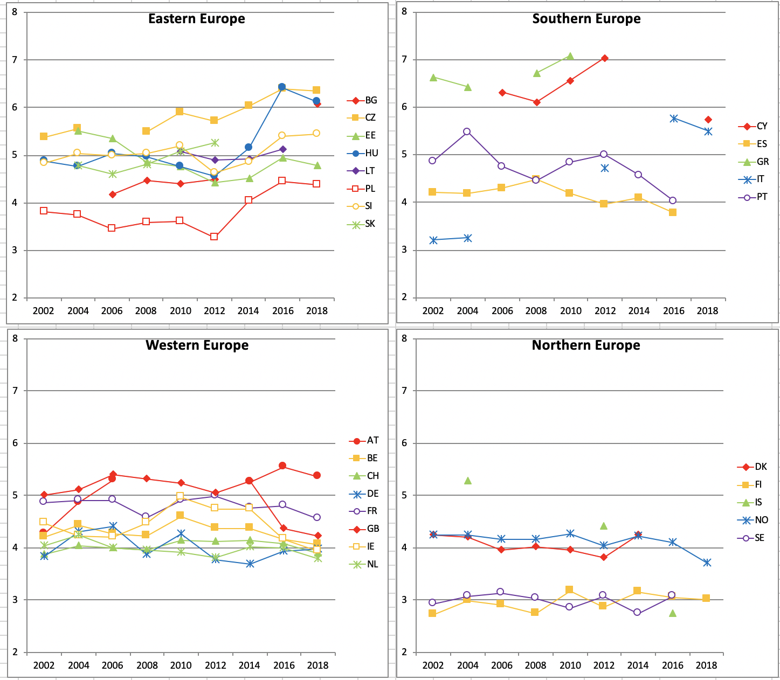
Economic threat perceptions

Slide 33
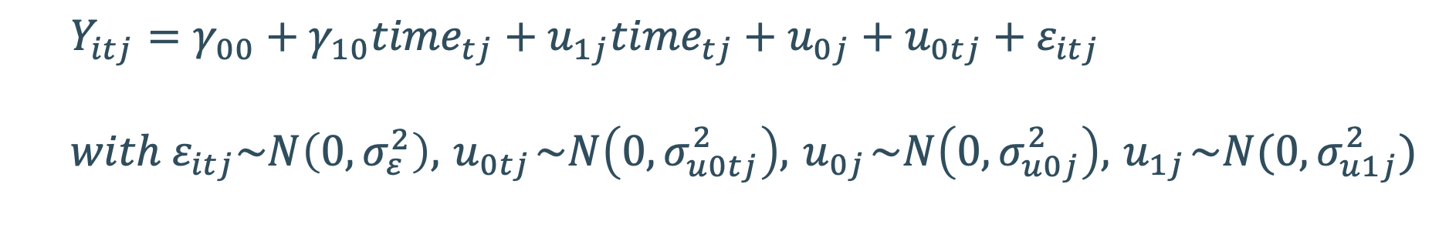
Illustration 1: perceived ethnic threat, ESS data
Fixed effects
Intercept
Time
Random effects
Level 3: Var. country intercept
Level 3: Var. slope time
Level 2: Var. country-year intercept
Level 1: Residual variance
Economic threat
Par. Est. | Sign.
4.163 | ***
0.018
0.549 | ***
0.004 | *
0.103 | ***
5.416 | ***
Cultural threat
Par. Est. | Sign.
4.541 | ***
0.017
0.899 | ***
0.005 | *
0.071 | ***
5.574 | ***
$$Y_{itj}=γ_{00}+γ_{10}{time}_{tj}+u_{1j}{time}_{tj}+u_{0j}+u_{0tj}+ε_{itj}$$
$$with{ ε}_{itj}\sim N\left(0,σ_{ε}^{2}\right), { u}_{0tj}\sim N\left(0,σ_{u0tj}^{2}\right), { u}_{0j}\sim N\left(0,σ_{u0j}^{2}\right),{ u}_{1j}\sim N(0,σ_{u1j}^{2})$$

Slide 34
Illustration 1: perceived ethnic threat, ESS data
Add individual & contextual variables to explain the various sources of variation
Context variables are entered at various levels to distinguish between…
Cross-sectional effects (between country) – people living in less prosperous countries feel more threatened
vs. longitudinal effects (within country) – in countries that become less prosperous, threat perceptions grow stronger
E.g. unemployment rate:
Cross-sectional component: average over whole time series
Longitudinal component: Year-specific deviation of that average
Differences in cross-sectional and longitudinal effects suggest omitted variable bias

Slide 35
Illustration 1: perceived ethnic threat, ESS data
Fixed effects - indiv. level
Gender
 | male
 | female (ref.cat.)
Age category
 | 16-24 years
 | 25-34 years
 | 35-44 years
 | 45-54 years (ref.cat.)
 | 55-64 years
 | 65-74 years
 | 75 years and over
Education
Subjective deprivation
Urbanization
Experience of unemployment
Economic threat
Par. Est. | Sign.
-0.201 | ***
-0.152 | *
-0.012
-0.015
0.047
0.079
0.102 | *
-0.106 | ***
0.299 | ***
0.108 | ***
0.069 | **
Cultural threat
Par. Est. | Sign.
0.107 | **
-0.185 | **
-0.061
-0.064 | **
0.109 | ***
0.245 | ***
0.326 | ***
-0.110 | ***
0.242 | ***
0.107 | ***
-0.020

Slide 36
Illustration 1: perceived ethnic threat, ESS data
Contextual effects – cross-sectional vs. longitudinal
 | Economic threat
Fixed effects - context level | Par. Est. | Sign.
Unemp. rate - Cross-sectional | 0.013
Unemp. - Longitudinal | 0.033 | *
GDP growth - Cross-sectional | -0.018
GDP growth - Longitudinal | -0.032 | **
Foreign migration - Cross-sectional | -0.024
Foreign migration - Longitudinal | -0.008
Cultural threat
Par. Est. | Sign.
0.065
-0.009
-0.020
-0.005
-0.020
0.001

Slide 37
Illustration 2: perceived ethnic threat, ISSP data
How does nationalism affect ethnic threat perceptions?
ISSP module on National Identity (1995, 2003, 2013)
23 countries
54 country-years
68,282 individuals
Indicators of economic & cultural threat perceptions (1 – 5 scale):
Immigrants take jobs away from people who were born in [COUNTRY]
[COUNTRY’s] culture is generally undermined by immigrants.
Nationalism (scale 1 – 5):
The world would be a better place if people from other countries were more like [nationality of respondent]
Generally speaking, [respondent’s country] is a better country than most other countries.
Based on: Callens & Meuleman (2024)

Slide 38
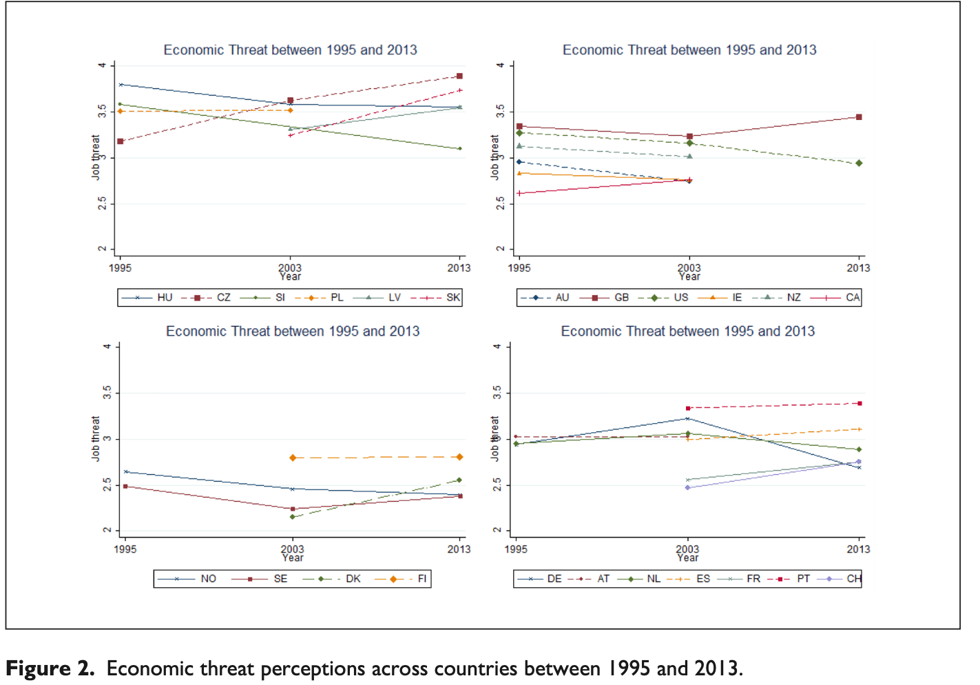
Illustration 2: perceived ethnic threat, ISSP data

Slide 39
Illustration 2: perceived ethnic threat, ISSP data
Variance decomposition – linear time effect

Slide 40
Illustration 2: perceived ethnic threat, ISSP data
Effect of nationalism at the 3 different levels

Slide 41
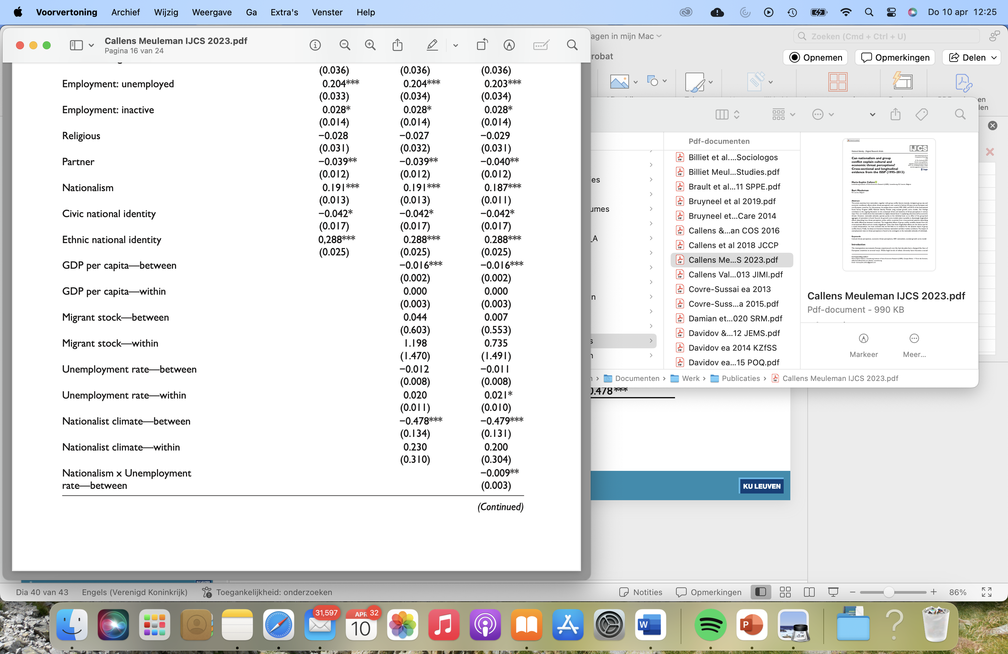
Illustration 2: perceived ethnic threat, ISSP data
Between and within effects on economic threat perceptions:

Slide 42
Take home messages
Time and place are two sources of contextual variation, that can be linked to different theoretical mechanisms
Within (longitudinal) vs. between (cross-sectional) effects
Three-level multilevel models can be used to separate these effects in cross-national repeated cross-sectional data
But: limited sample size requirements at country & time point level can affect precision & statistical power
These models provide a tool to gain insights that go beyond hard-to-interpret total effects
But findings can be puzzling!

Slide 43
References
Callens, M. S., & Meuleman, B. (2024). Can nationalism and group conflict explain cultural and economic threat perceptions? Cross-sectional and longitudinal evidence from the ISSP (1995–2013). International Journal of Comparative Sociology, 65(2), 205-228.
Curran, P. J., & Bauer, D. J. (2011). The disaggregation of within-person and between-person effects in longitudinal models of change. Annual review of psychology, 62(1), 583-619.
Fairbrother, M. (2014). Two multilevel modeling techniques for analyzing comparative longitudinal survey datasets. Political Science Research and Methods, 2(1), 119-140.
Meuleman, B., Davidov, E., & Billiet, J. (2018). Modeling multiple-country repeated cross-sections: a societal growth curve model for studying the effect of the economic crisis on perceived ethnic threat. Methods, data, analyses: a journal for quantitative methods and survey methodology (mda), 12(2), 185-209.

Slide 44
Questions?

